Slide 1
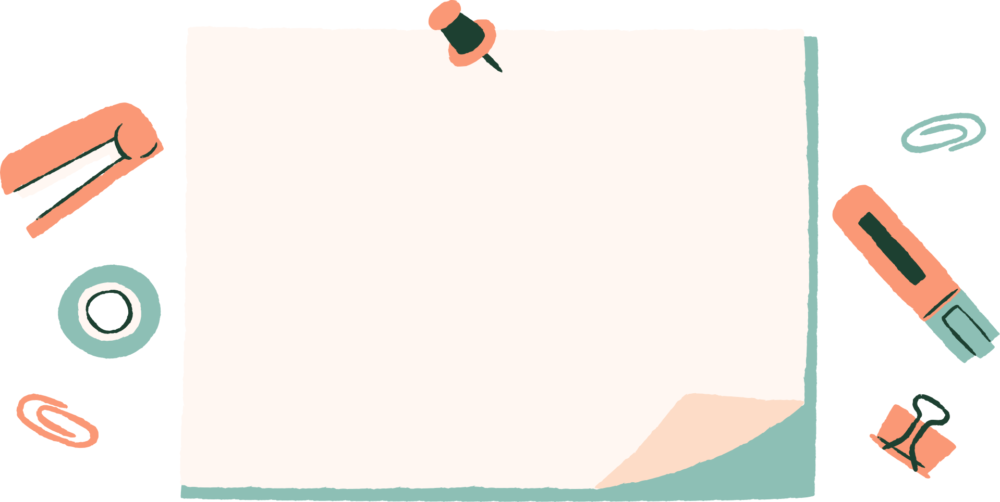




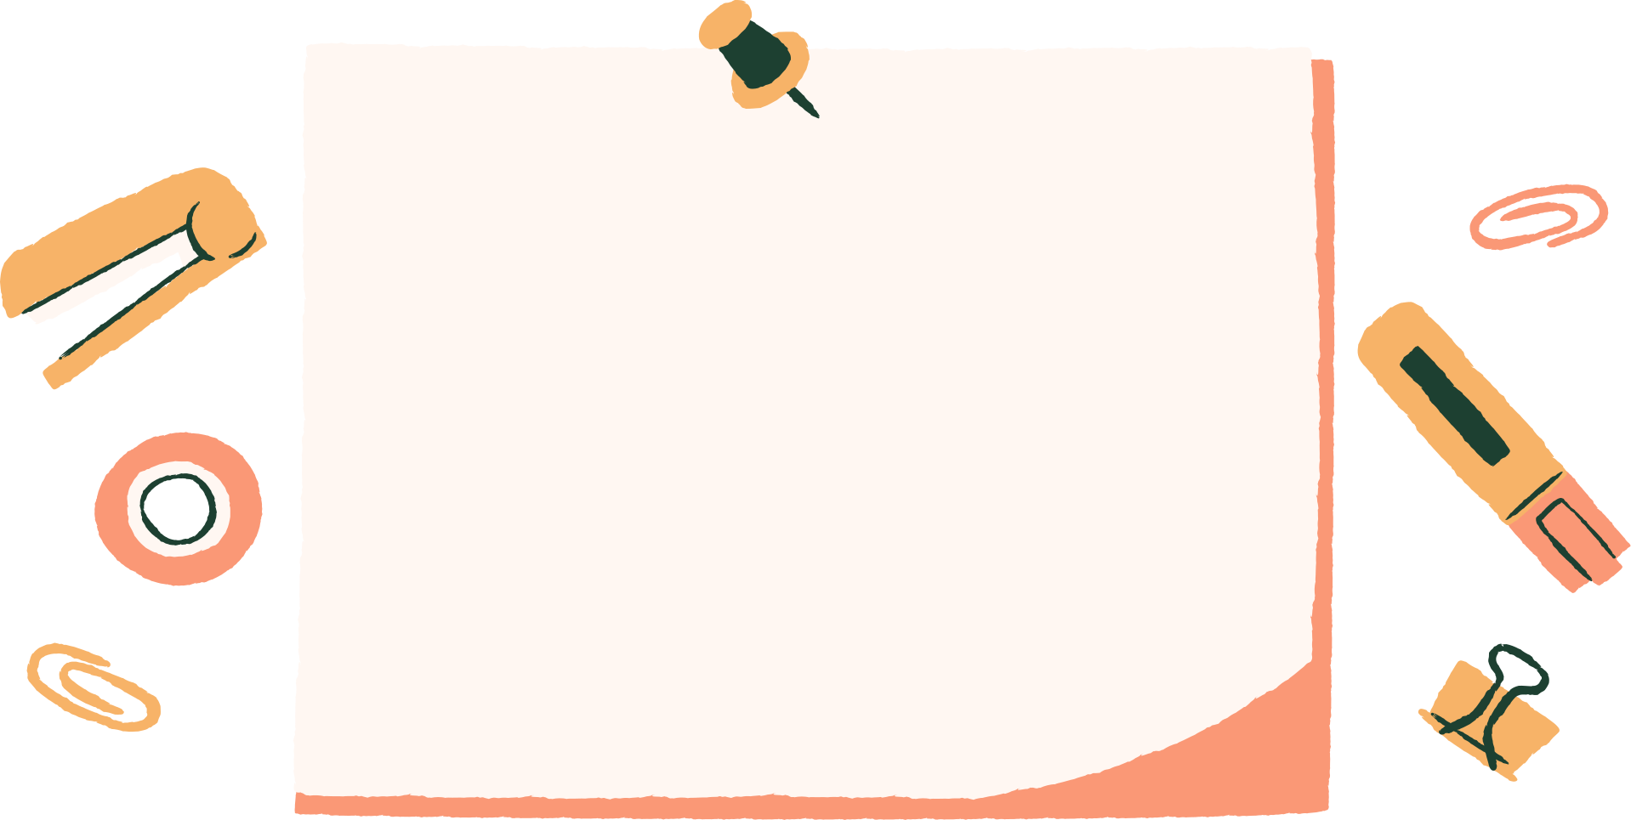
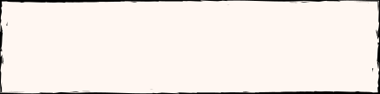


YEAR 2 MATHS
Amy Walker

Slide 2


To get an insight into how Maths is taught at Honeywell.
AIMS OF SESSION
To provide information on some of the key mathematical concepts that your child will learn in Year Two
To take away some ideas to support your child at home

Slide 3




HOW?
MASTERY APPROACH:
ACQUIRING A DEEP, LONG-TERM, SECURE AND ADAPTABLE UNDERSTANDING OF THE SUBJECT.
Fluency
Reasoning
Problem Solving

Slide 4

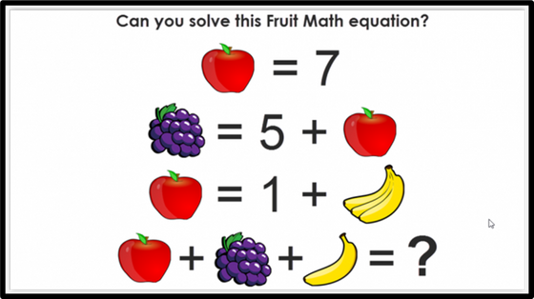
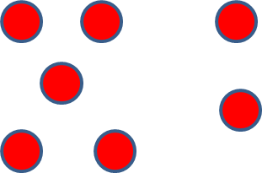
FLUENCY, REASONING, PROBLEMSOLVING
Fluency
Reasoning
Problem Solving
Automatic recall. Not just knowing but understanding securely enough that
it frees up brain space.
5 + 6 = 11
Using this fact, how can you work out what
5 + 7 =

Slide 5

PD MATERIALS
MATHS SPECIALIST
MATHS HUB

Slide 6
Number
  Place Value
  Addition & Subtraction
  Multiplication & Division
  Fractions
Measure
Geometry
WHAT?
NATIONAL CURRICULUM
ASSESSMENT FRAMEWORK
Statistics

Slide 7

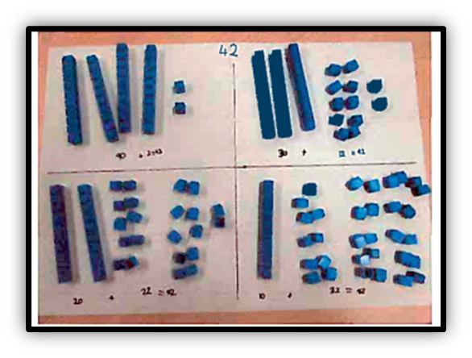
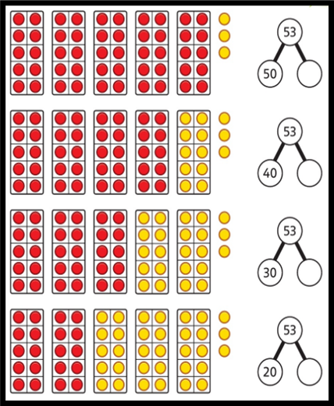
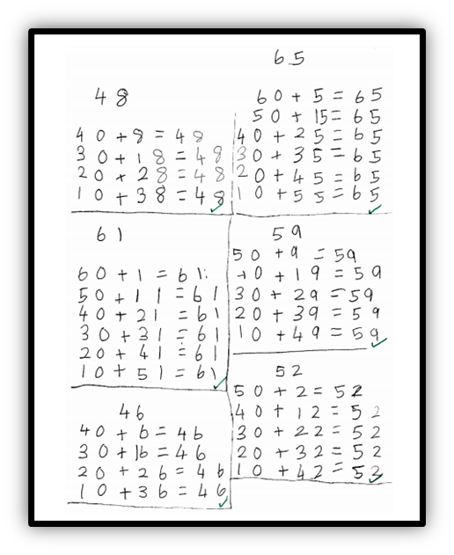


PLACE VALUE
Partition any two-digit number into different combinations of tens and ones, explaining their thinking verbally, in pictures or using apparatus

Slide 8
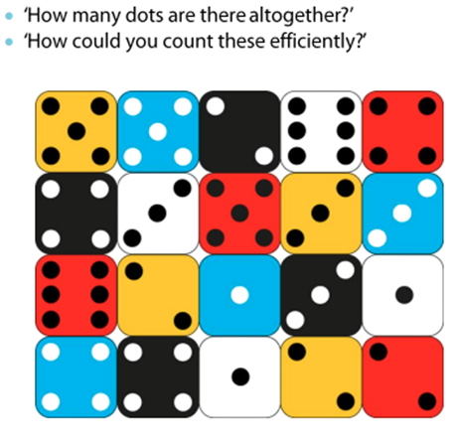
PLACE VALUE
Partition two-digit numbers into different combinations of tens and ones.
This may include using apparatus.
Reasoning

Slide 9
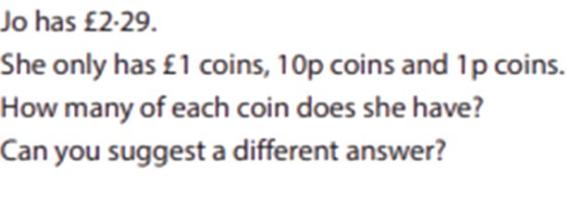
PLACE VALUE
Partition two-digit numbers into different combinations of tens and ones.
This may include using apparatus.
Problem Solving

Slide 10
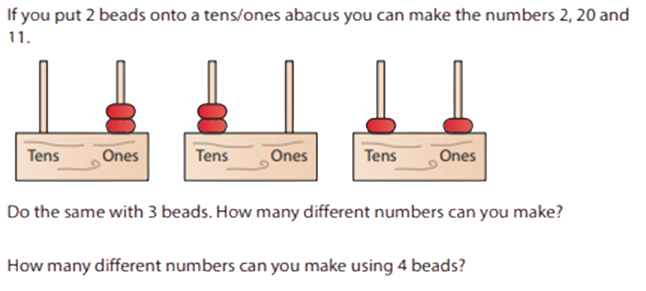
PLACE VALUE
Partition two-digit numbers into different combinations of tens and ones.
This may include using apparatus.

Slide 11
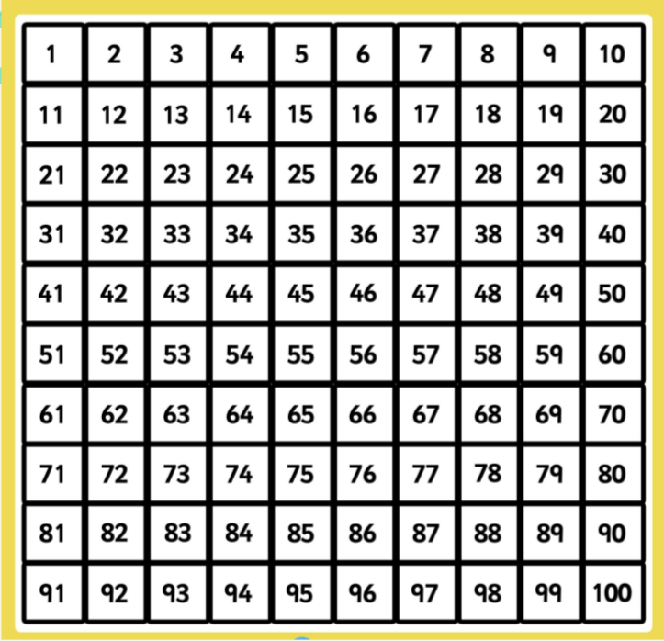
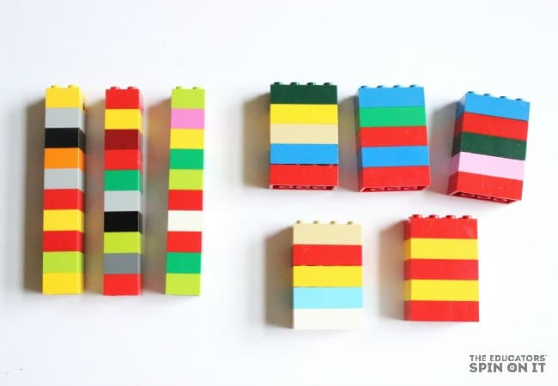
PLACE VALUE AT HOME
Close your eyes choose a number. How many tens how many ones?
Can they do this using objects eg. 10ps and 1ps?
Can they find their own representations eg. a pencil represents 10. A bead represents ones. Can they partition into different combinations?
Plot the ages of all the adults in your family on the number square, How many tens how many ones?
Point out the efficiency of counting in 10s and ones as opposed to just ones. Can they group large quantities eg lego into tens and ones. How many ways can they partition these groups?

Slide 12

ADDITION SUBTRACTION
Recall all number bonds to and within 10 and use these to reason with and calculate bonds to and within 20, recognising other associated additive relationships – for example:
If 7 + 3 = 10, then 17 + 3 = 20; if 7 – 3 = 4, then 17 – 3 = 14; leading to if 14 + 3 = 17, then 3 + 14 = 17, 17 – 14 = 3 and 17 – 3 = 14
Add and subtract any 2 two-digit numbers using an efficient strategy, explaining their method verbally, in pictures or using apparatus
for example: 48 + 35, 72 – 17

Slide 13

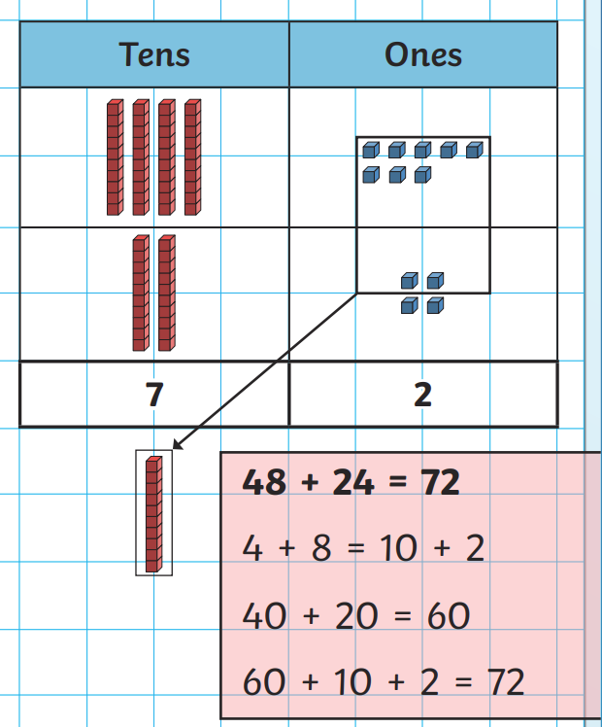
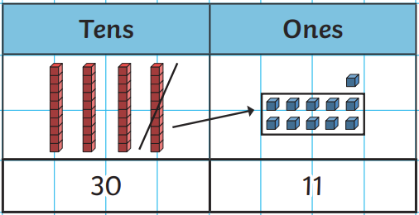
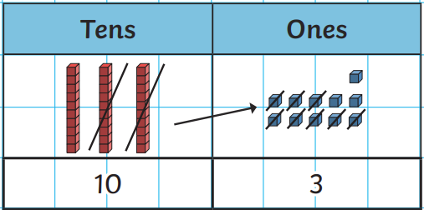
ADDITION
SUBTRACTION

Slide 14
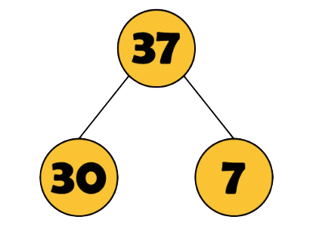
ADDITION
SUBTRACTION
NC: RECOGNISE THE INVERSE RELATIONSHIPS BETWEEN ADDITION AND SUBTRACTION AND USE THIS TO CHECK CALCULATIONS AND WORK OUT MISSING NUMBER PROBLEMS

Slide 15
ADDITION
SUBTRACTION
THERE ARE FOUR ADDITION CALCULATIONS HIDDEN BELOW.
YOUR CHALLENGE IS TO PUT THEM IN ORDER, FROM EASIEST TO HARDEST. TRY TO DO THIS WITHOUT ACTUALLY CALCULATING EACH ANSWER IF YOU CAN.
42 + 47
42 + 18
42 + 39
42 + 3
HOW DID YOU DECIDE THE ORDER?
WE WOULD LOVE TO HEAR THE REASONS FOR YOUR FINAL ORDER.

Slide 16
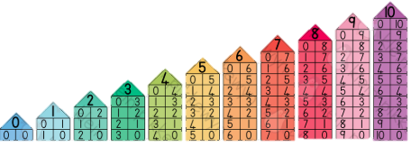
NUMBER BONDS AT HOME
Can your child fluently recite all number bonds to a given number within 10
Can they recognise the pattern, (eg as one part goes up, the other part goes down) and use this to reason?
Can they use their knowledge of number bonds within 10 and relate to number bonds within 20

Slide 17
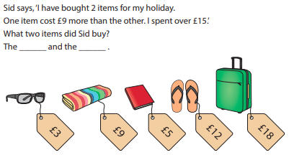

ADDITION AND SUBTRACTION AT HOME
Money questions
Alice bought a monster using only silver coins. It cost her 45p.How many different ways could she pay for it?
Pretend shops
Questions which allow children to be the teacher. 23 + 15 = 30. Is this correct? Explain/show how you know!
Select a number on the 100 square each. What is the difference? How can we check/ show this?
Representations of part whole models and how addition is linked to subtraction. Missing number problems

Slide 18




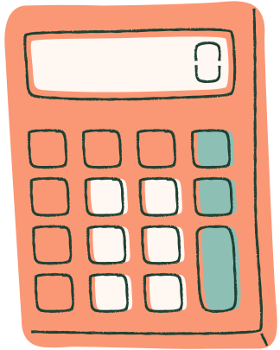


MULTIPLICATION
& DIVISION
RECALL AND USE MULTIPLICATION AND DIVISION FACTS FOR THE 2, 5 AND 10 MULTIPLICATION TABLES TO SOLVE SIMPLE PROBLEMS, DEMONSTRATING AN UNDERSTANDING OF COMMUTATIVITY AS NECESSARY

Slide 19
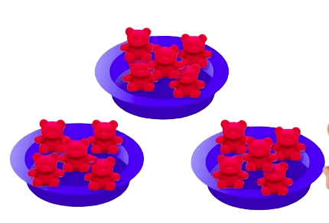
3 X 5 = 15
I HAVE 3 GROUPS OF 5

Slide 20
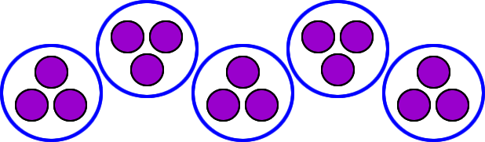
5 X 3 = 15
I HAVE 5 GROUPS OF 3

Slide 21
SHARING
15 ÷ 3 = 5
15 SPLIT INTO 3 GROUPS = 5 IN EACH

Slide 22
SHARING
÷
15 5 = 3
I HAVE 5 GROUPS WITH 3 IN EACH GROUP

Slide 23
GROUPING
15 ÷ 3 = 5
15 SPLIT INTO GROUPS OF 3 = 5 GROUPS

Slide 24
GROUPING
÷
15 5 = 3
I HAVE GROUPS OF 5 BEARS
3 GROUPS ALTOGETHER

Slide 25
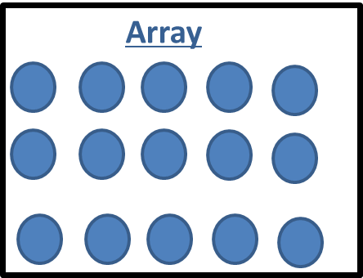

Slide 26
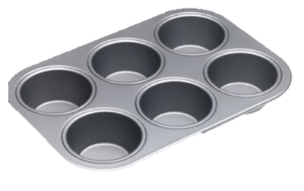
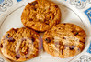
MULTIPLICATION AND DIVISION
AT HOME
Learn the 2, 3, 5 and 10 times table. Not just by ‘chanting, but also by being able to recall facts randomly e.g. 3 x 5 / 10 x 2 etc.
When carrying out laundry duties/tidying bedrooms, ask how many pairs of socks there are, can they count them in 2s?
Ask your child to share fruit/sweets out equally between family members using their knowledge of the 2, 3, 5 or 10 times table. Will there be any remainders?
Look for arrays that you can count in 2s, 3s, 5s and 10s around the home
Count 2 pence, 5 pence and 10 pence coins to find totals.

Slide 27
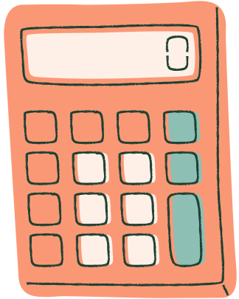
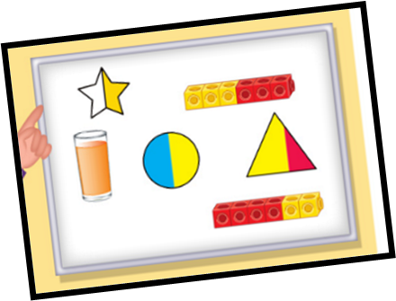
FRACTIONS
IDENTIFY ¹⁄₃, ¼, ½, ²⁄₄, ¾ AND KNOW THAT ALL PARTS MUST BE EQUAL PARTS OF THE WHOLE
WHAT IS A WHOLE?
WHAT IS A PART?

Slide 28
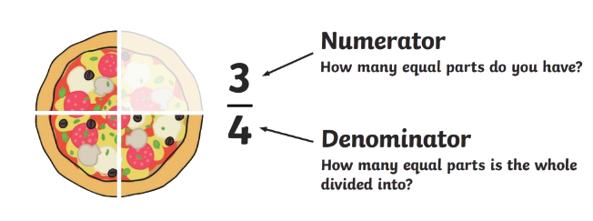
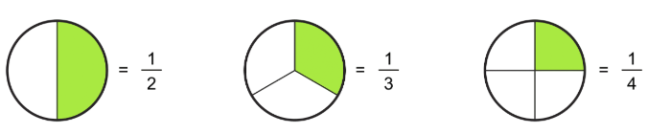
FRACTIONS

Slide 29
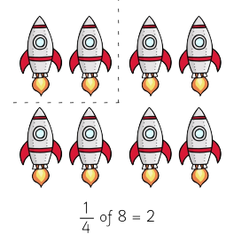
FRACTIONS

Slide 30
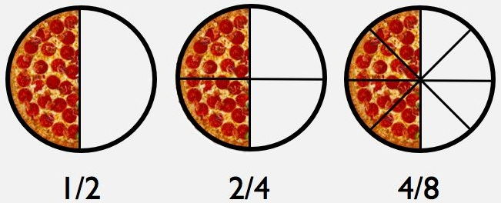
FRACTIONS AT HOME
During cooking activities and meal times encourage your child to cut their cake, pizza or sandwich into fractions. Talk about how each slice is 1 of however many parts.
Make the connection between sharing/dividing and fractions i.e. ½ = ÷ 2, ¼ = sharing by 4. Practise this with practical objects. Eg. I need a quarter of those marbles.
Identify which fractions are the same. 1 slice of toast is cut in halves, one slice is in quarters. How many of the quarters are the same as a half?
Running distances. Half, quarter etc

Slide 31
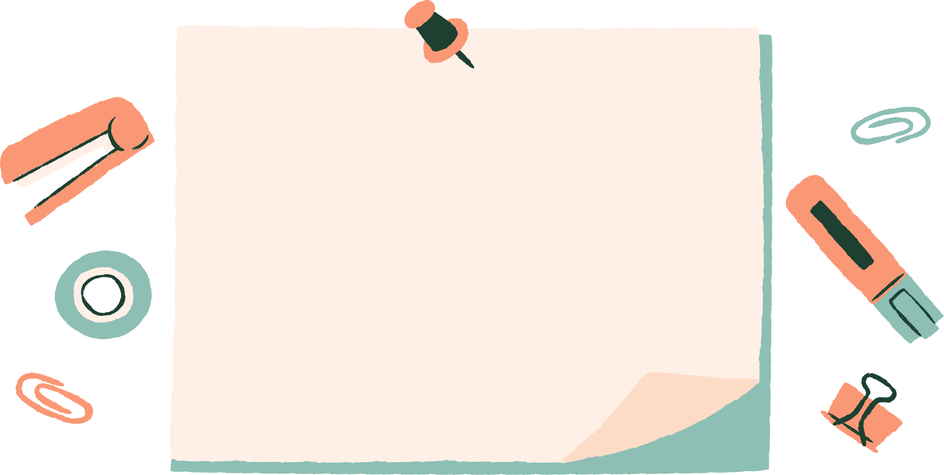
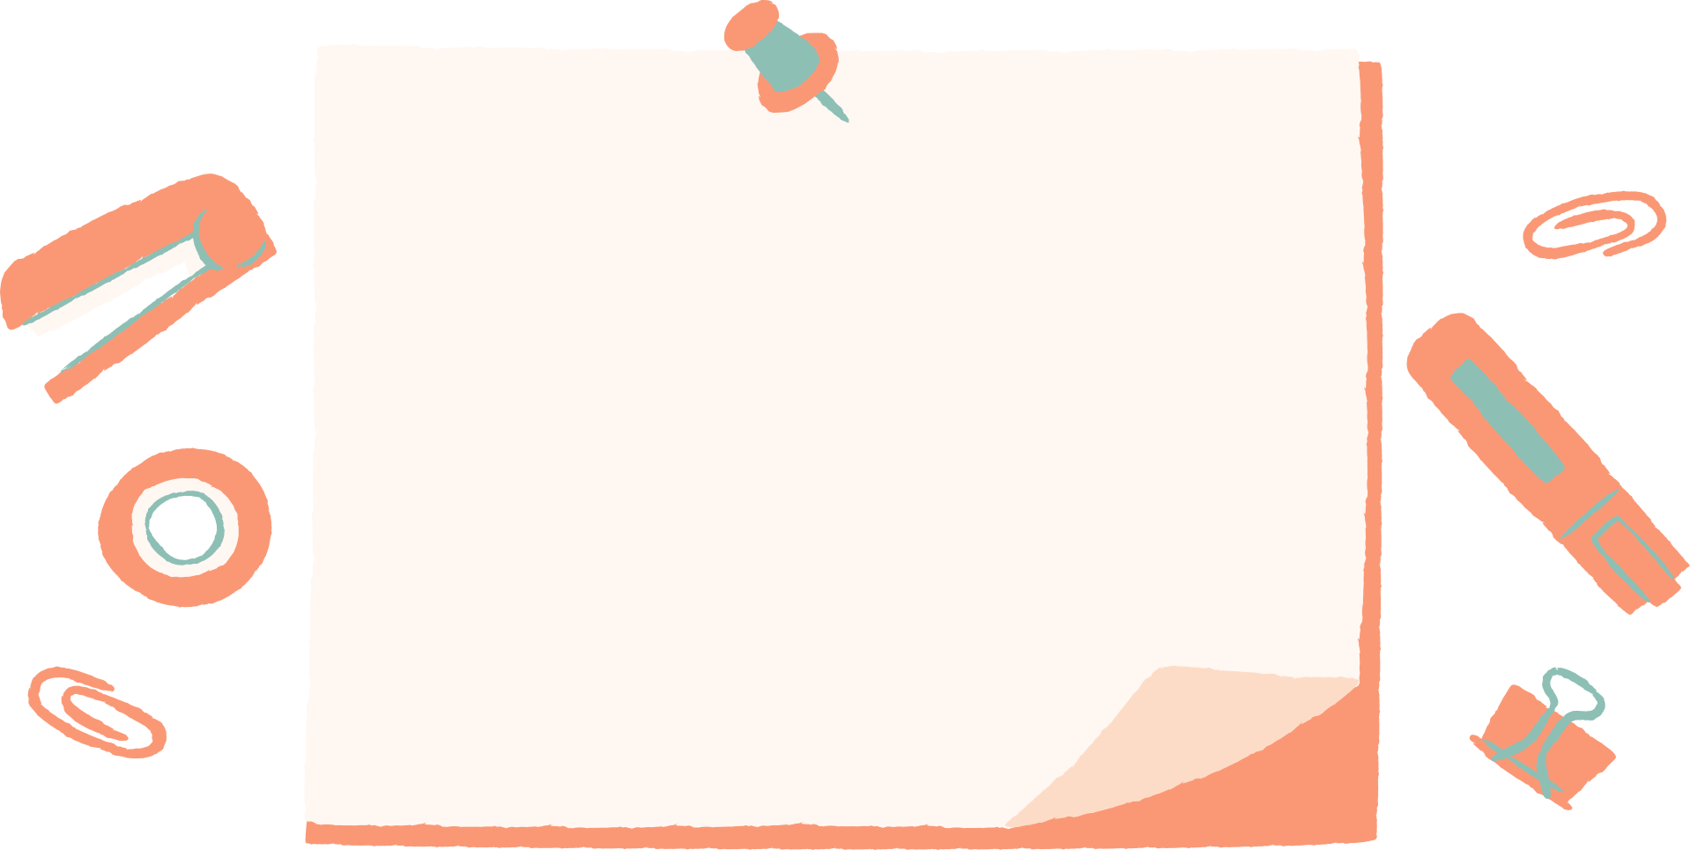

MATHS IS FUN
nrich.maths.org
(parents and teachers section)
1 minute Maths (white rose)

