Slide 1


Slide 2
Two main documents: The National Curriculum informs teaching and The Teacher Assessment Framework informs assessment (Now non-statutory)
Children assessed over the course of the year
Final assessment is reported as
‘working towards the expected standard’
‘working at the expected standard’
‘working at greater depth within the expected standard’

Slide 3
Spoken Language
runs through all curriculum areas
Reading
word reading
comprehension
Writing
transcription (spelling and handwriting)
composition
vocabulary, grammar and punctuation

Slide 4

Notes:
Integrated throughout the curriculum
Focus on topic specific words
Immersion, drama, reenactment (discovery Den helping to bring this to life)
Often learning stories orally so the structure is internalized

Slide 5

Notes:
Children read with weekly

Slide 6
The Expected Standard
read accurately most words of two or more syllables
read most words containing common suffixes*
read most common exception words*
read words accurately and fluently without overt sounding and blending and sufficiently fluently to allow them to focus on their understanding rather than on decoding individual words
sound out most unfamiliar words accurately, without undue hesitation
Greater Depth: NA (all GD statements for reading refer to understanding and discussion)
Notes:
These are the technical elements of reading
Phonics all the phases have now been learnt.
Year 2 have differentiated phonic sessions where children who are confident with all sounds get practise applying them and others get taught according to their gaps
Please see hand out for the common exception words and suffixes for year 2

Slide 7
Expected Standard
In a book that they can already read fluently, the pupil can:
check it makes sense to them, correcting any inaccurate
reading
answer questions and make some inferences
explain what has happened so far in what they have read
Greater Depth
The pupil can, in a book they are reading independently:
make inferences
make a plausible prediction about what might happen on the
basis of what has been read so far
make links between the book they are reading and other
books they have read

Slide 8
Through story time, teachers may model key skills of comprehension strategies:
Inferring
How do you know?
What does the author ‘show’ not ‘tell’ us?
Making connections
with other texts, other authors, other versions of that story, with personal experiences.
Predicting
Making plausible predications based on what has been read so far.
Summarising
Retelling the main parts of a story in their own words
Questioning
Asking questions about plot, character actions, meanings of unknown words to ensure understanding
Visualising
Creating pictures in their heads as they read.
Notes:
Have a go at using the comprehension strategies at home: inferring, making connections, predicting, summarising, questioning and visualising​

Slide 9


Slide 10

o transcription (spelling and handwriting)
o composition
o vocabulary, grammar and punctuation

Slide 11
Expected Standard
segment spoken words into phonemes and represent these by graphemes, spelling many of these words correctly and making phonetically plausible attempts at others
spell many common exception words
Greater Depth
spell most common exception words
add suffixes to spell most words correctly in their writing

Slide 12
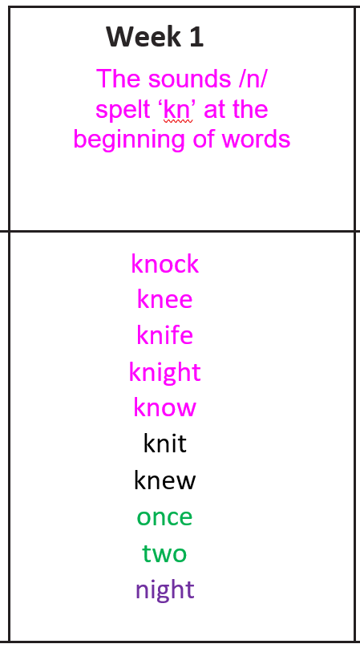
10 words sent home weekly.
Linked to the NC.
Application of spelling rule
taught in school that week.
As well as common exception words and common homophones.
Practise in a way that works
for you.
Short spelling test the
following week.

Slide 13
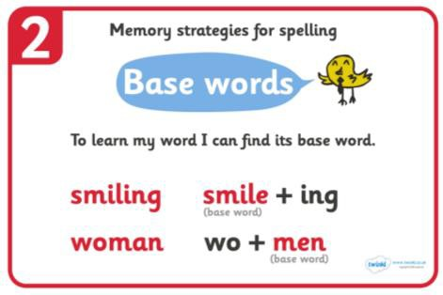
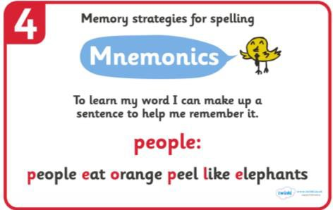
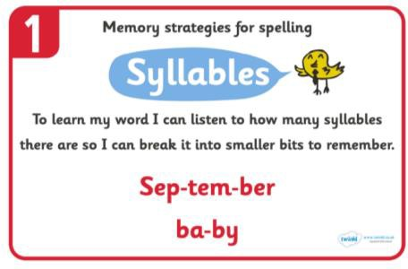
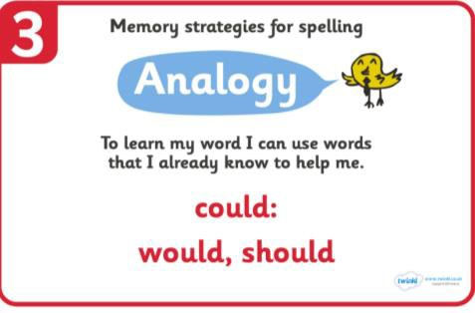
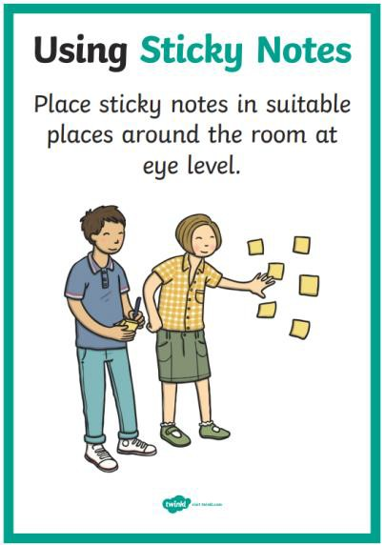


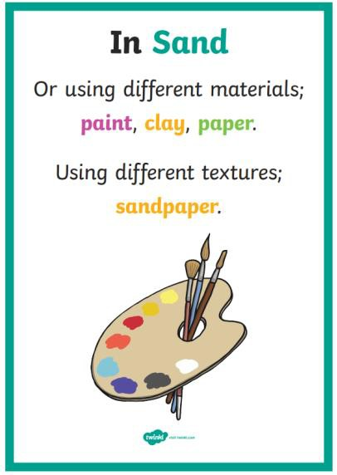
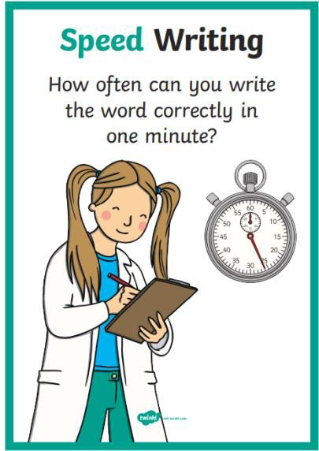
When practising your spellings, choose a strategy that works for you.

Slide 14
Expected Standard
form capital letters and digits of the correct size, orientation and relationship to one another and to lower-case letters
use spacing between words that reflects the size of the letters
Greater Depth
use the diagonal and horizontal strokes needed to join some letters

Slide 15
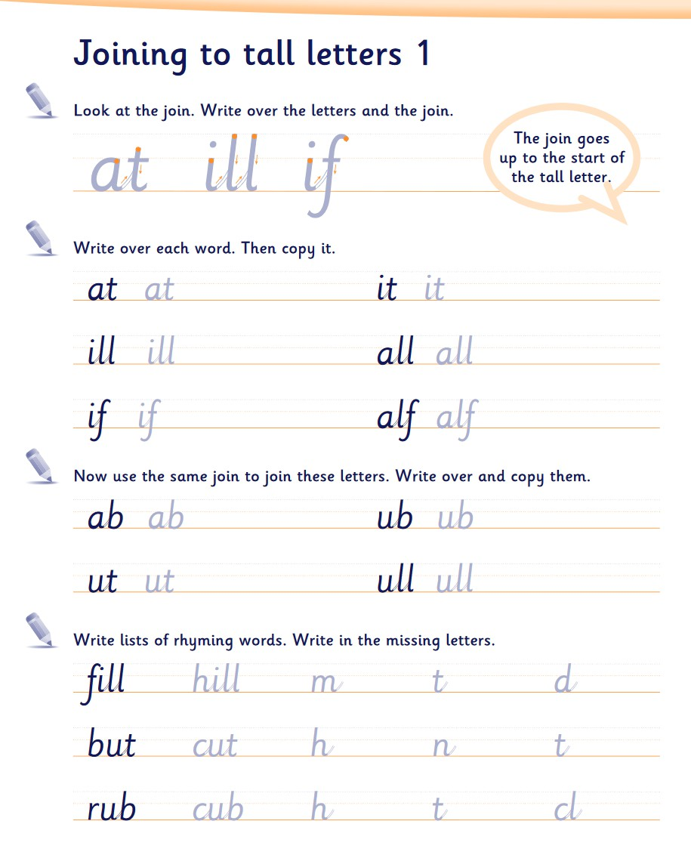
From Autumn 2
Focus on developing diagonal and horizontal strokes needed to
join letters (not cursive)

Slide 16
Expected Standard
demarcate most sentences in their writing with capital letters and full stops, and use question marks correctly when required
use present and past tense mostly correctly and consistently
use co-ordination (e.g. or / and / but) and some subordination (e.g. when / if / that / because) to join clauses
Greater Depth
use the punctuation taught at key stage 1
mostly correctly

Slide 17
ABC ... Capital Letters Beginning of a sentence Name of person or place I Days of Week or Month
. Full Stop | ? Question Mark | ! Exclamation Mark | , Comma for separating items in a list | ’ Apostrophe singular possession e.g. Poppy’s pen contractions e.g. don’t, I’m
Notes:
Teaching is integrated into the English curriculum in Year 2.
Also taught as a discreet subject each week.

Slide 18

Expected Standard
write simple, coherent narratives about personal experiences and those of others (real or fictional)
write about real events, recording these simply and clearly
Greater Depth
write effectively and coherently for different purposes, drawing on their reading to inform the vocabulary and grammar of their writing
Make simple additions, revisions and proof- reading corrections to their own writing

Slide 19
Explicit Writing Process
Read
Book talk/grammar/vocabulary/drama
Genre features
Plan
Draft
Edit and improve
Notes:
Teach the process that an author might go through. Teaching the children that they ARE writers.
Ok to make mistakes and just have a go – support children who are less keen to write.
Offers opportunities for challenge for all children at each stage.

Slide 20
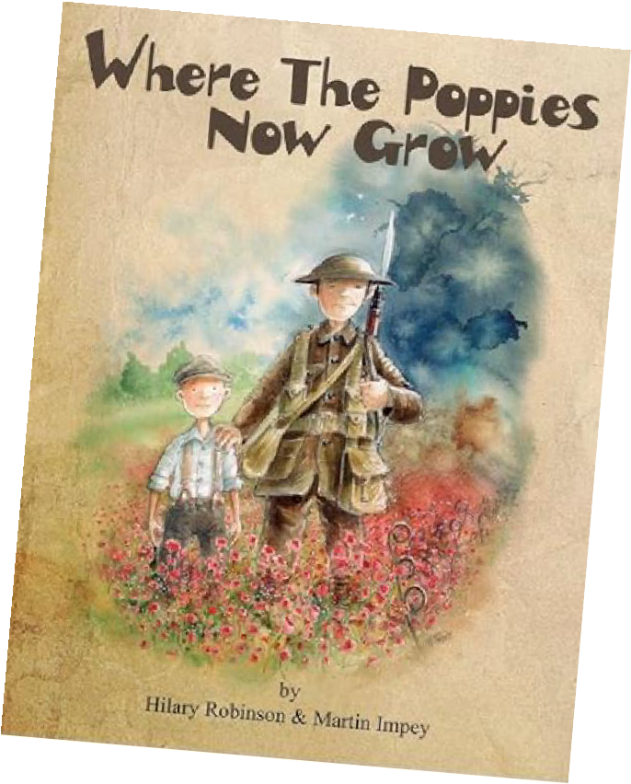

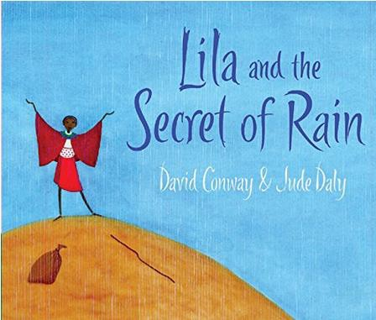
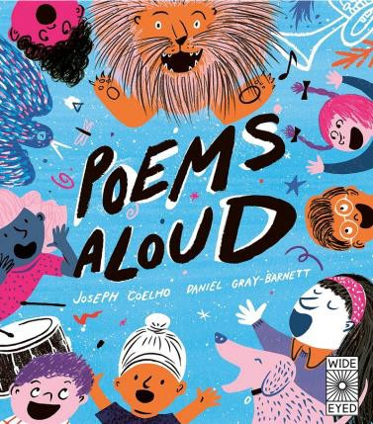
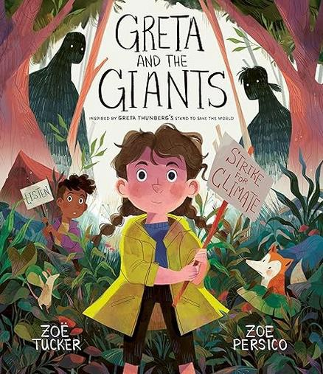
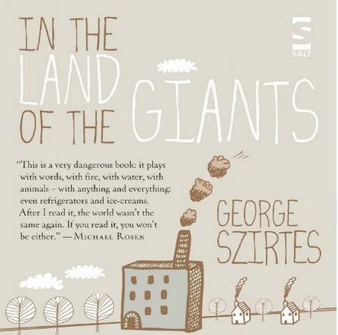
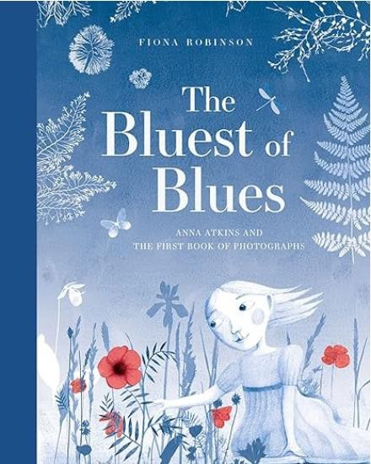

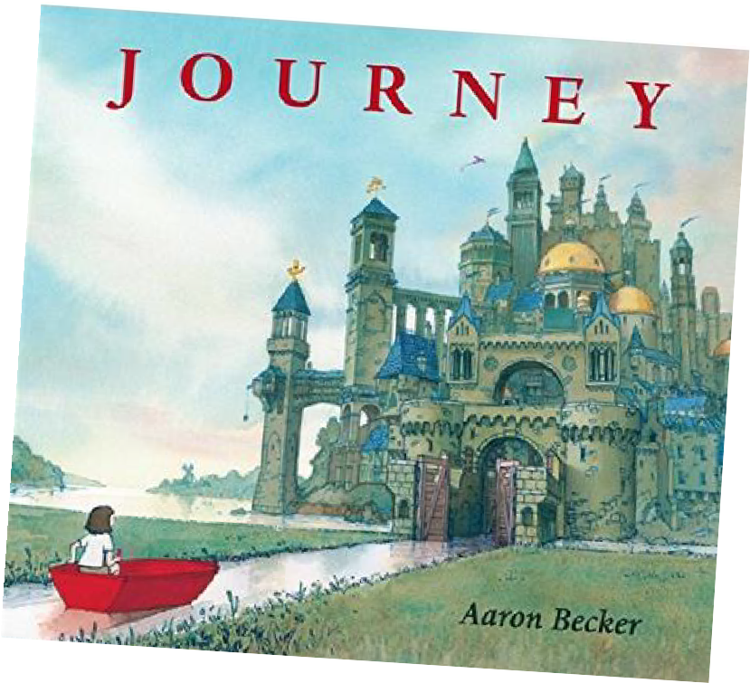
Read
High quality texts are used as stimulus for writing.
Notes:
Begin each sequence of a learning with a high quality text.
Stimulus for drama, C&L, art and writing tasks and are more often than not linked to half termly topics.

Slide 21
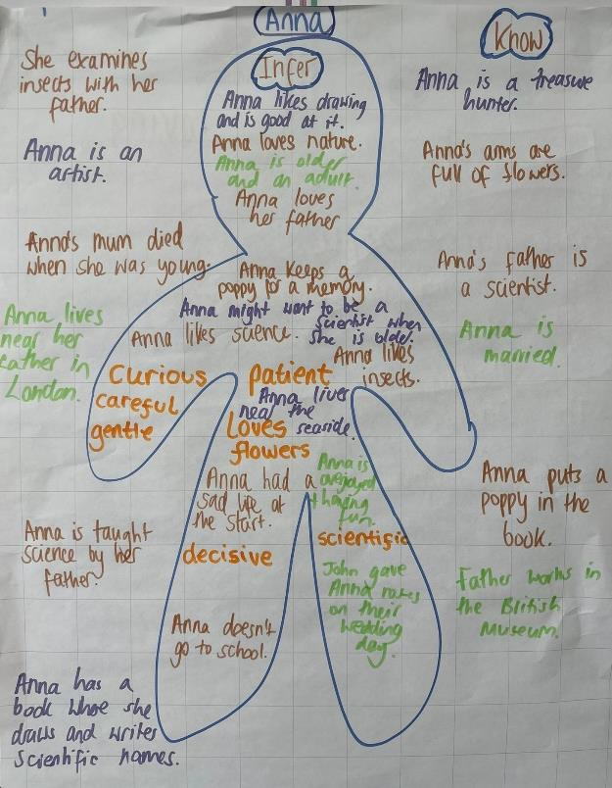
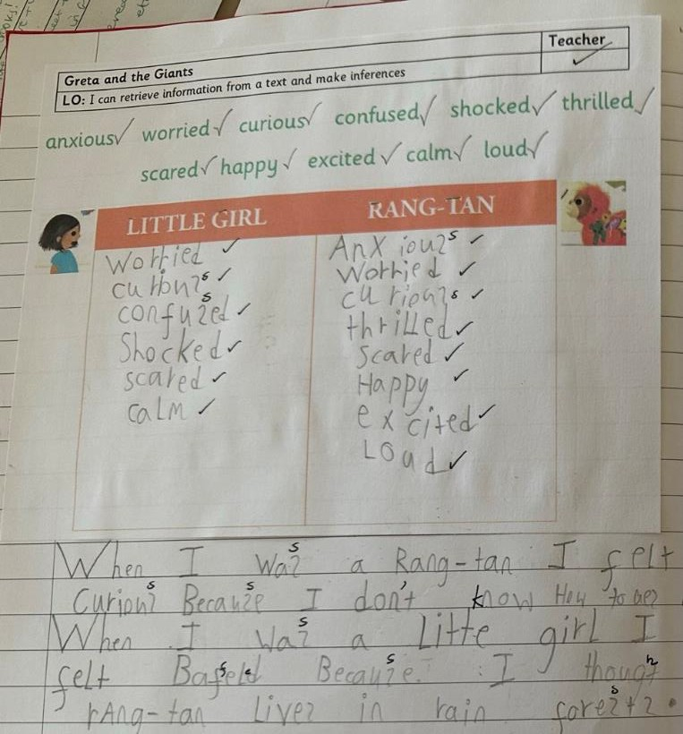
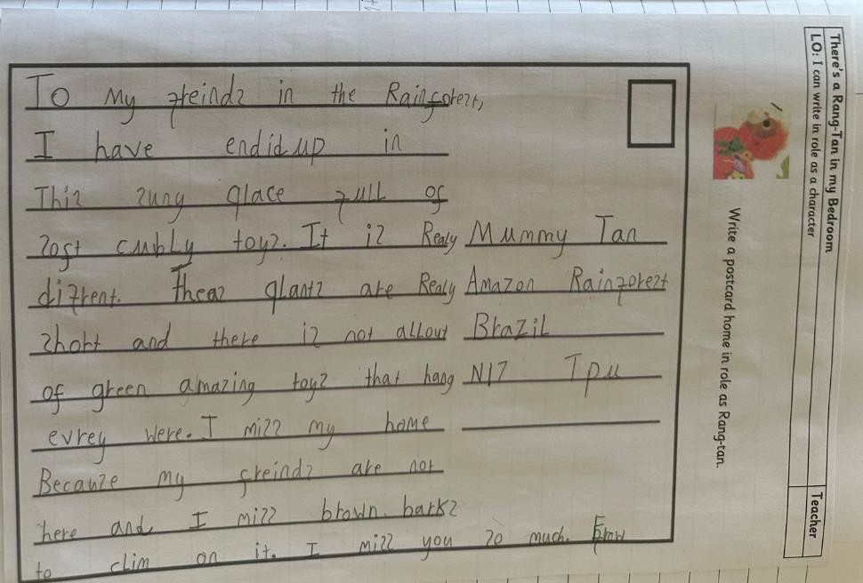
Book talk/grammar/vocabulary/drama
Develops understanding of the text
Notes:
First stage in the writing process – reading and discussing the book.
Develop understanding of the text through role play, exploration of character, setting, vocabulary.
Short writing tasks to get into role as a character or explore themes within the text.

Slide 22
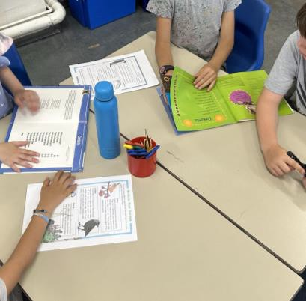
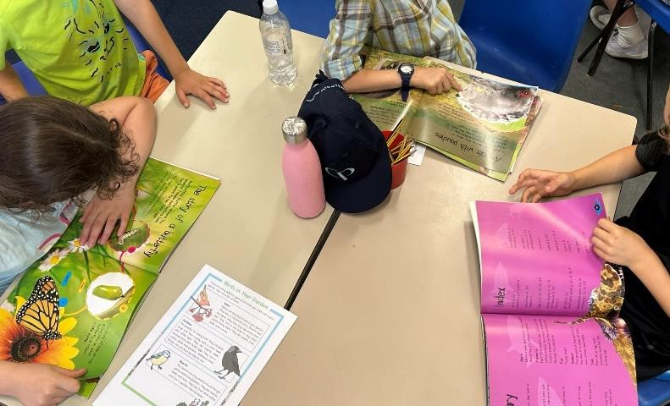
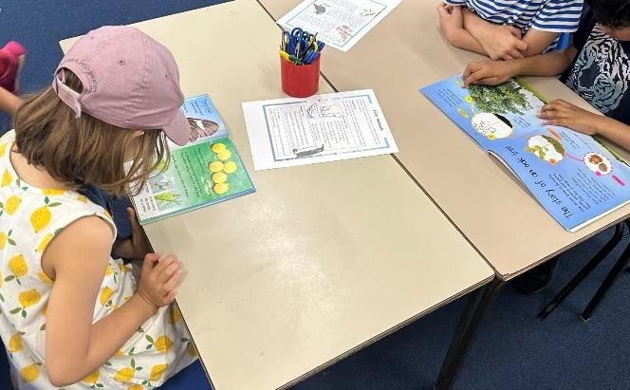
Genre features
What do these texts have in common?
Co-construct success criteria
Notes:
Children explore high quality versions of the type of text they are going to write – such a letter, persuasive text, non-chronological report, newspaper.
Identify similarities between the examples and work as a class or group to co-construct a list of features or success criteria for writing that particular genre.
For example; A non chronological report might contain, headings, subheadings, fact boxes, be written in the present tense and information is grouped into paragraphs or themes.

Slide 23
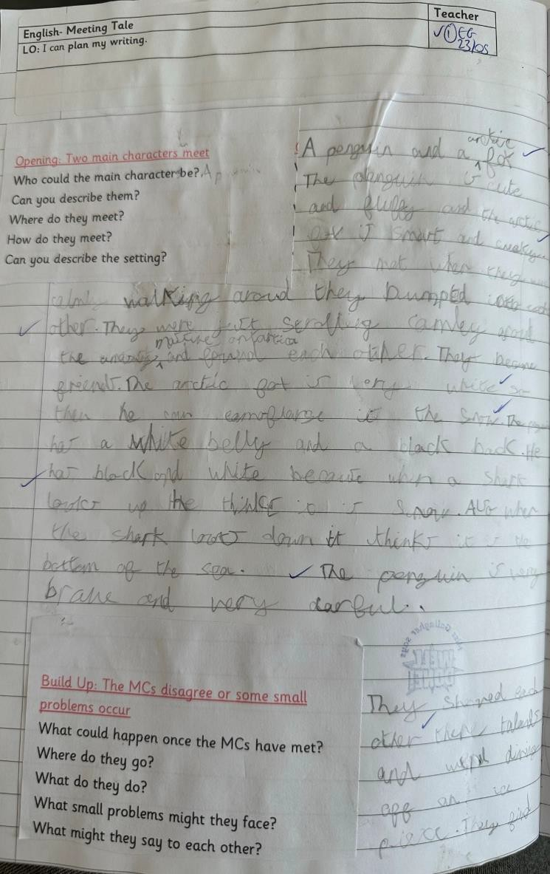
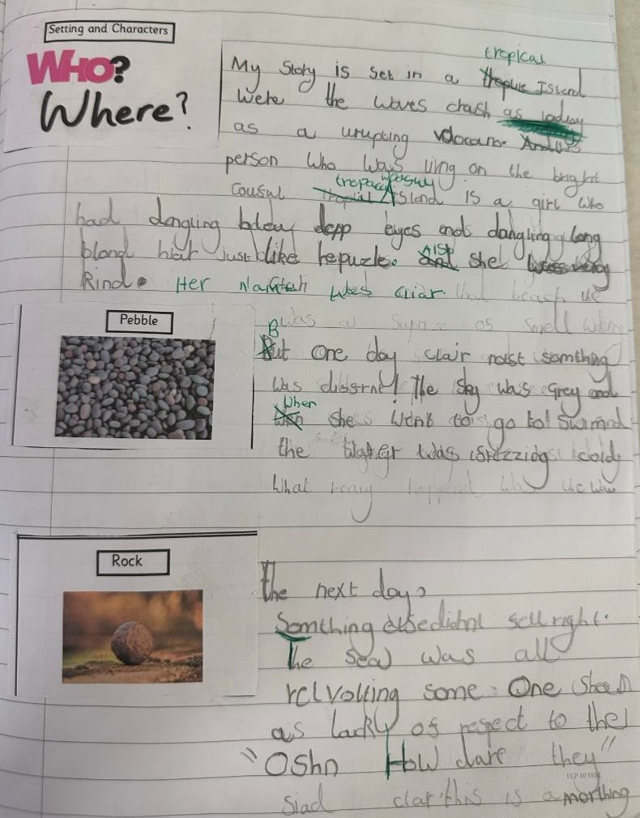
Plan
What will I write?
What vocabulary will I use?
What is the structure of my writing?
Notes:
The planning stage enables children the opportunity to record their ideas without too much of a focus on the transcriptional elements. It is an important part of the process to support children with sequencing and organising their work, including a range of the features of each particular text and is their opportunity to apply all they have learnt during the prewriting tasks/book talk and get these onto paper.
Plann9ing stages are scaffolded for the children. Mind maps, stickers, story mountains, story maps.
It offers teachers a great opportunity to address misconceptions, extend and challenge the children and talk with them about their ideas before they even begin drafting.

Slide 24
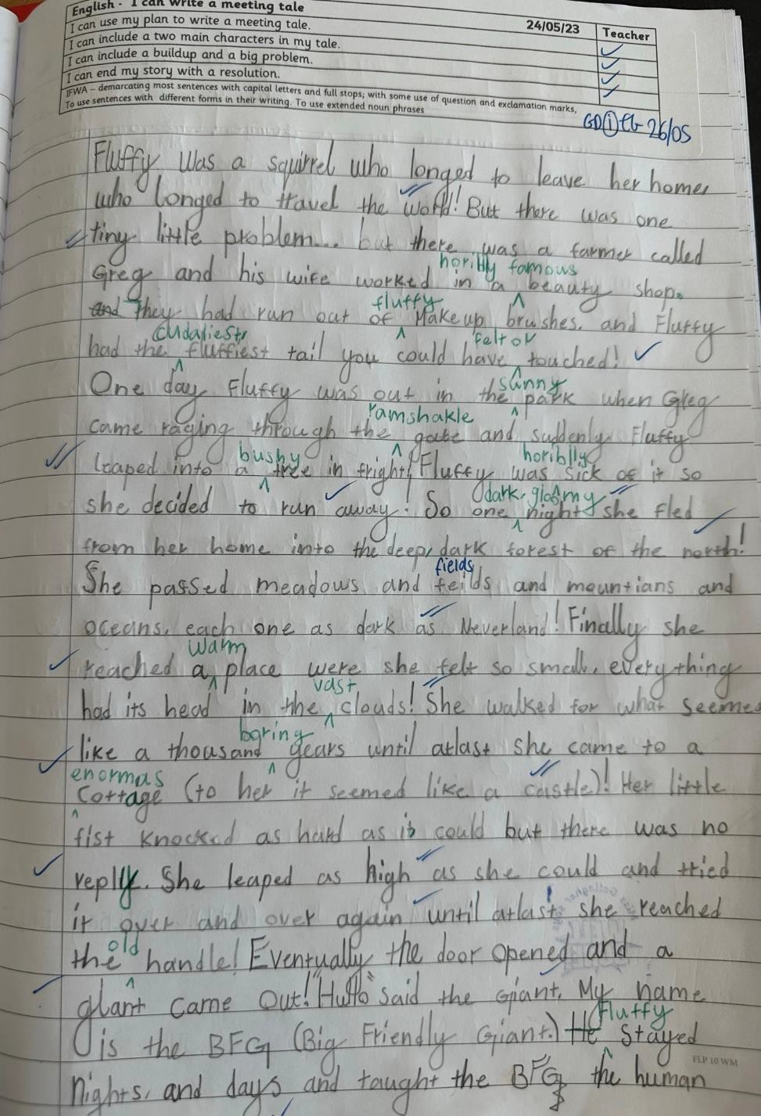
Edit and improve
Draft
Notes:
Using their plans – which in year 2, have probably been reworked simply to include edits and improvements with adulkt support, the children will begin their first draft.
Using the ideas from their plan to produce their extended writing.
Both during the drafting session and after using our marking code, the children have multiple opportunities to revisit their work and make edits such as spelling and grammar – and improvements – such as including a wider range of adjectives to create imagery or using different senytence starters.

Slide 25
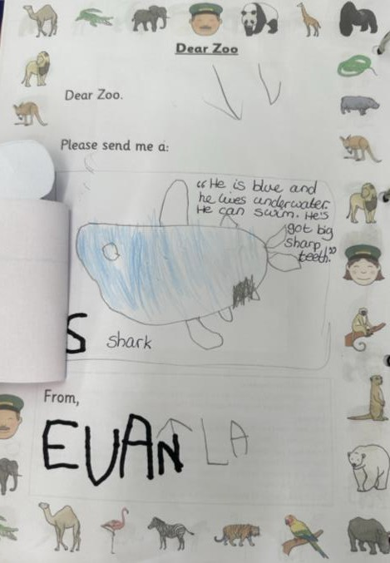
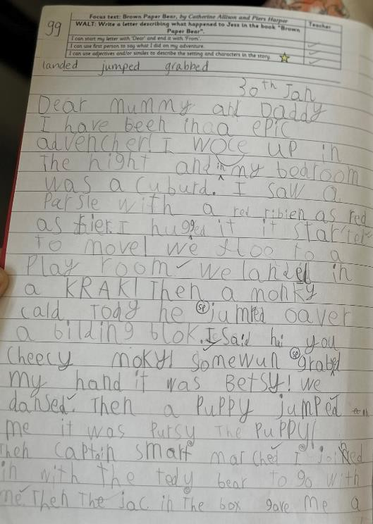
Build up of knowledge and skills
Nursery
Year 1
Notes:
Throughout Early years and KS!, there is a build up of knowledge and skills. The children are introduced to a bvariety of text types at an early age and these are developed and built upon as they move through the school.
Example – letter writing. Nursery, features of a letter provided, children encouraged to write their name and content is scribed from child’s voice.
In this year 1 example, children are expected to include more of those genre features independently – including dear and From, including informnation about what they did and including some description of characters and settings.

Slide 26
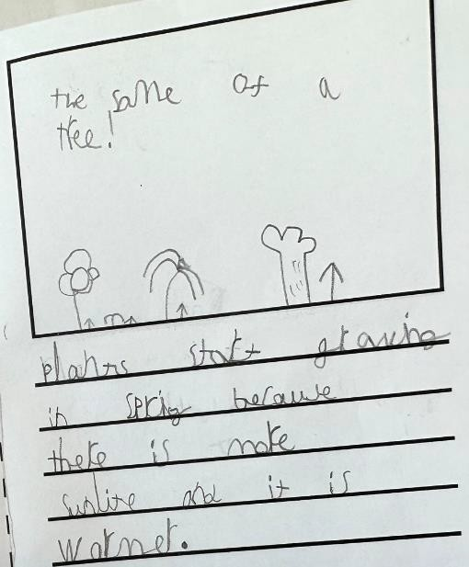
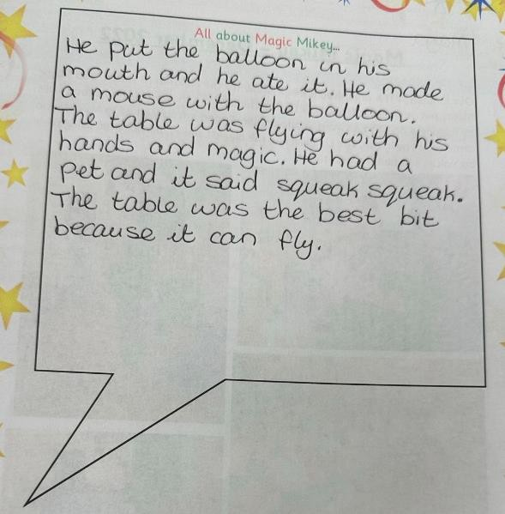
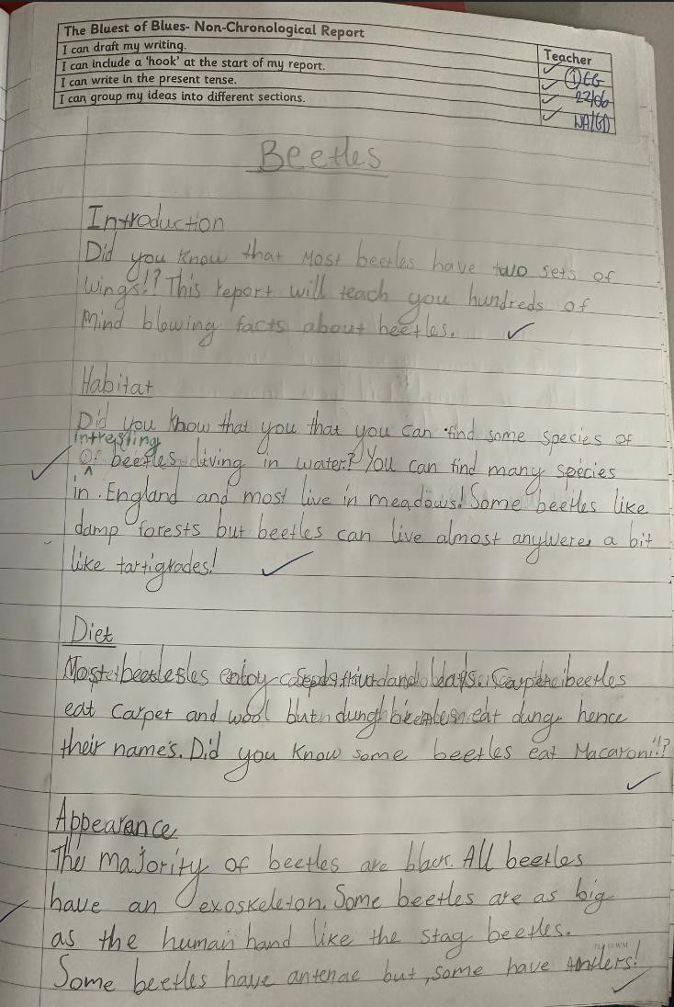
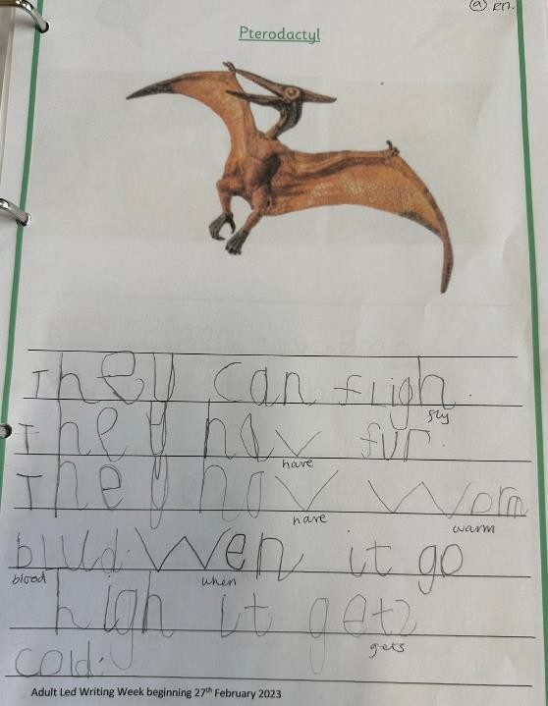
Build up of knowledge and skills
Year 2
Reception
Year 1
Nursery
Notes:
Another example for a non-chronological report.
Nursery – to share with a teacher about an event they took part in – scribed by an adult.
Reception – information text about dinosaurs recorded in simple sentences.
Year 1 – booklet about spring where the children are beginning to organise their ideas into themes with adult support.
Year 2 – Non-Chronological report about beetles – a range of features such as themed paragraphs. Year 2 focus on the gramnmatical and punctuation features of a text too – in this case questions such as Did you know? And bullet points for a list.

Slide 27

Pie Corbett “I noticed that the best writers were the children who read avidly. It seemed obvious that these children had been internalising narrative patterns – the language of stories – and recycling them in their head”.
Notes:
When writing fiction, we use Pie Corbett’s T4W approach to narratives.
He suggested that the majority of stories fall into categories and contain the same key plot points. We teach the children these narrative structures so they are able to write their own well structured stories.

Slide 28

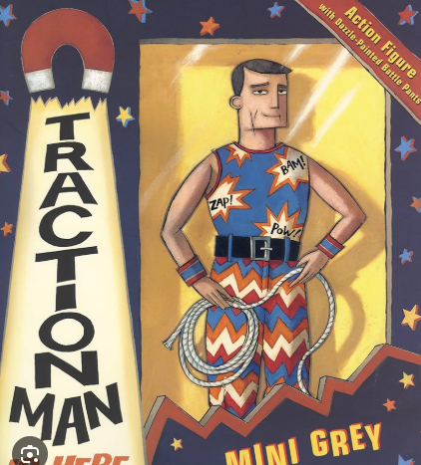

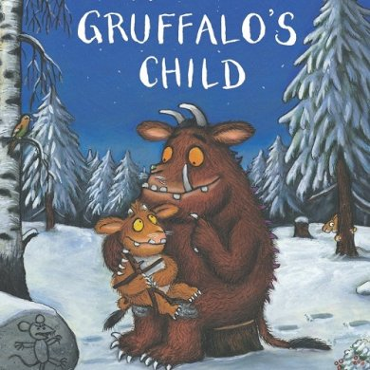

Losing Tale
Journey Tale
Conquering the Monster Tale
Character Flaw Tale
Repetitive Tale
Wishing Tale
Meeting Tale
Notes:
By the end of year 2, the children will have read, studied and written their own version of a range of different story types. Each of these story types can be broken down into simple plot patterns that children can replicate when creating their own stories.

Slide 29
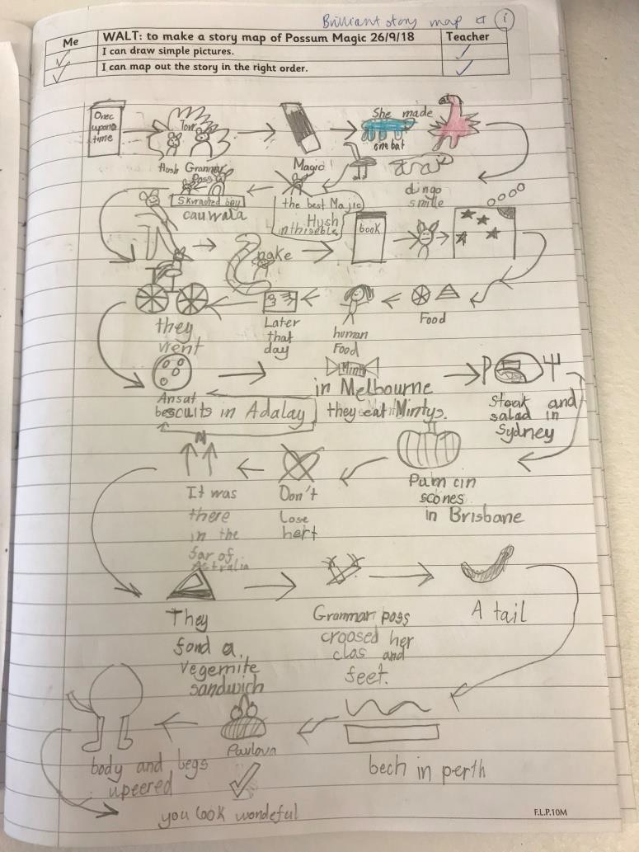
Notes:
The children internalise the story and practise performing it aloud as a class and in groups through the use of actions. Once they have learnt the story by heart, they are abke to create a story map of the key evets and language from the story to use as support in their writing.

Slide 30
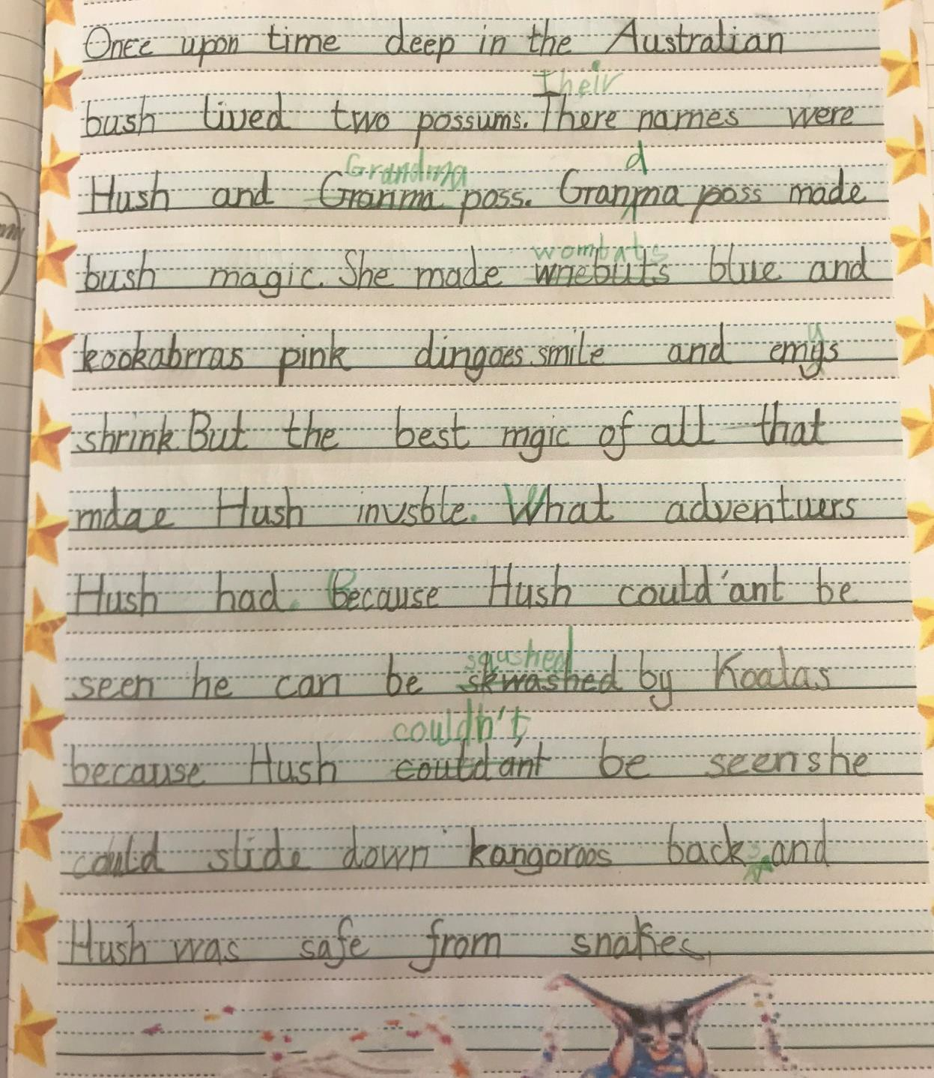
Notes:
Using the internalised story language alongside their story map, the children are able to write down the story from memory. This whole process supports children to then create their own version of a particular story using ;learnt story language and following the generic plot structure of each particular narrative.

Slide 31
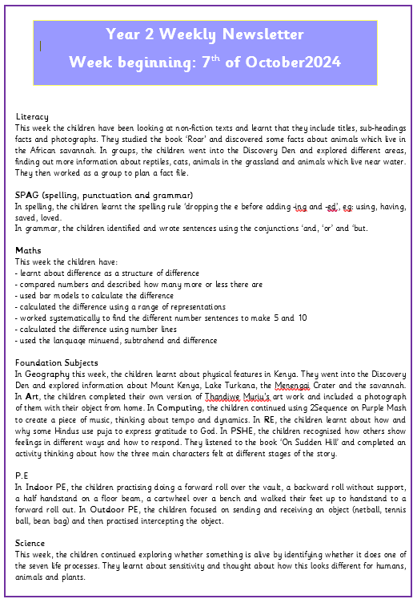
Weekly Newsletter

