Slide 1

Welcome to
Reception

Slide 2
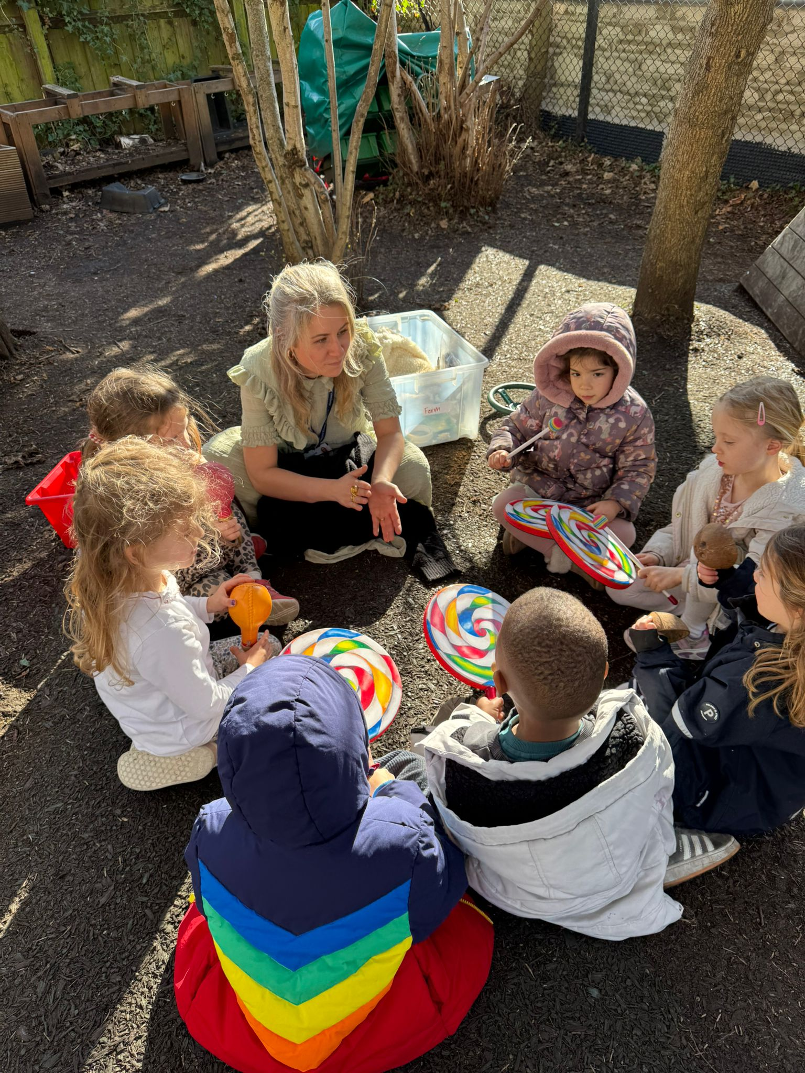
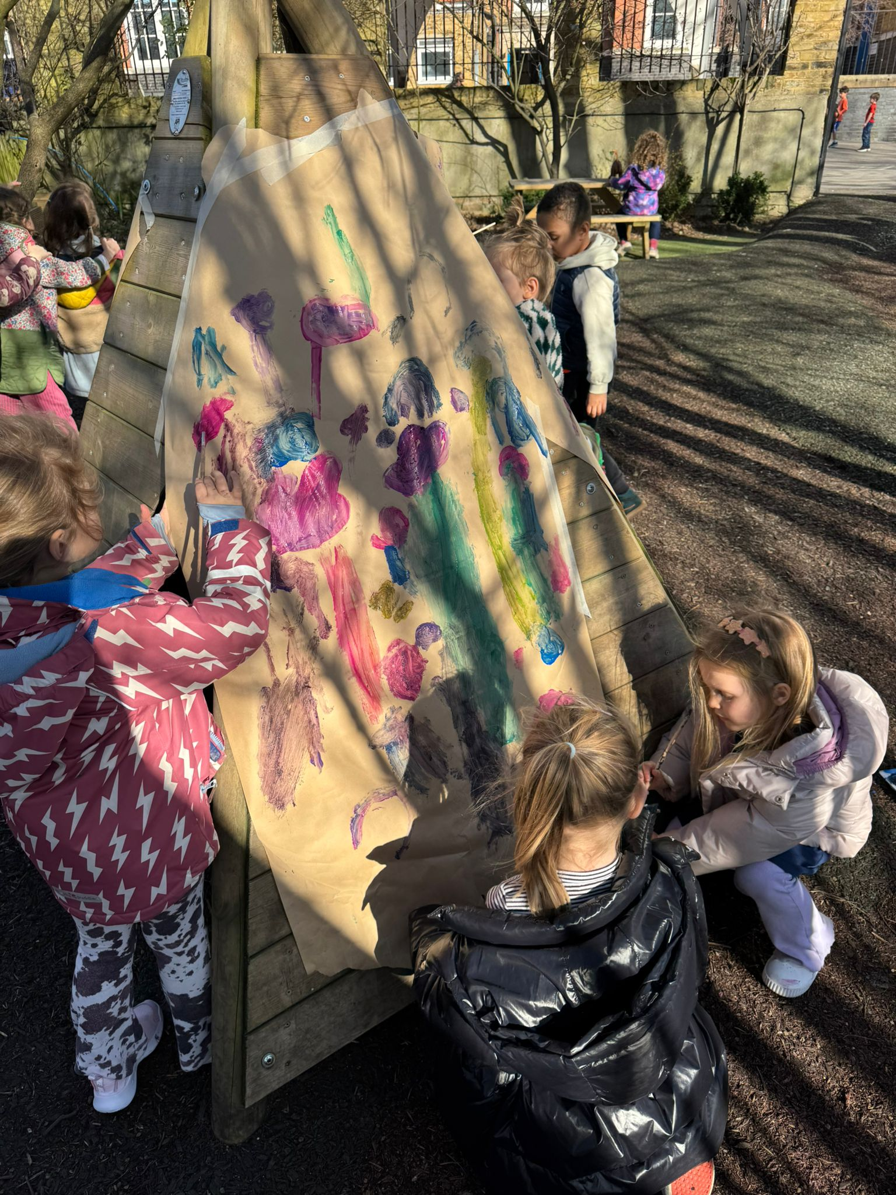
A Reception Day
8.50 – 9am Soft Start
9:00 - 9.05am Register
9.05 - 9.25am – Phonics
9.30 - 10.15am – Discovery Time / Adult Led Activities
10.15 - 10.30am – Playtime (Pirate Ship)
10.30 - 10.45am – Snack and Story Time
10.45 - 11.35am – Discovery Time / Adult Led Activities
11.35 - 12.45pm - Lunch and Lunchtime Play
12.45 – 12.50pm Afternoon Register
12.50 – 1pm – Maths
1 – 1.30pm – Discovery Time
1.30 – 2.45pm – Free Flow / Adult Led Reading
2.45 – 3.30pm – Whole Class Carpet Time
Home Time:
This will be staggered and change throughout the year. Please see Seesaw for updates.
9:05-9:25am- Whole Class Phonics Carpet Time
9:30-10:15am- Choosing Time/Adult Led Activities
10:15-10:30am- Playtime
10:30-10:45am- Fruit, Milk and Story
10:45-11:35am- Choosing Time/Adult Led Activities
11:40-12:45pm- Lunch and Lunchtime Play
12:45pm- Afternoon Register
12:45-1:00pm- Whole Class Maths Carpet Time
1:30-2:50pm- Free-Flow (Adult led activities, reading groups)
2:55pm-3:20pm- Whole Class Topic Carpet Time

Slide 3
Reception Half Termly Topics
Autumn 1 – People Who Help Us
Autumn 2 – Polar Regions
Spring 1 – Castles
Spring 2 – Dinosaurs
Summer 1 – London
Summer 2 – Superheroes
Autumn 1 – People Who Help Us
Autumn 2 – Polar Regions
Spring 1 – Castles
Spring 2 – Dinosaurs
Summer 1 – Ready, Steady, Grow!
Summer 2 – London

Slide 4



What your child will need for school each day:
A named water bottle
A named bag/bookbag
Named clothing dependent on the weather each day
(coat, sunhat)

Slide 5
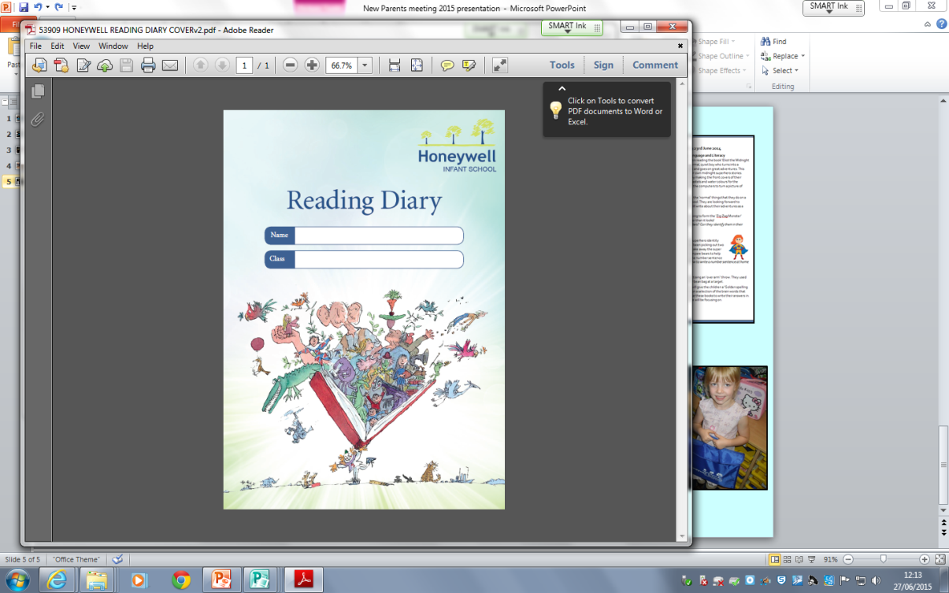

Communication- Home & School
Drop Off and Pick Up
You can give your child’s class teacher a brief message at the start and end of each school day if needed.
Class Teacher Email
You can contact your child’s class teacher during term time by email, if you have any questions or queries pertinent to your child.
Seesaw
Each week you will receive an update on what your child has been learning at school that week, with any important information about the following week. This will be the principle way to communicate with you about teaching and learning.
Drop-Off and Pick-Up Times
You can give your child’s Class Teacher a brief message at the start and end of each school day if needed.
Class Teacher Email
You can contact your child’s Class Teacher during term-time by email if you have any questions or queries pertinent to your child.
Reception Class Newsletter
Each Friday you will be emailed a Reception Class Newsletter with information about what your child has learnt at school that week and with any important information about learning for the following week. This weekly Reception Class Newsletter will be the principle way to communicate with you about teaching and learning.

