Slide 1
Reception Maths
2026 - 27

Slide 2
Aims of the session
- How
- What
- Support at home

Slide 3

NCETM
(Mastering Number Programme)

Slide 4

The Stable Order Principle
The one-one Principle
The Cardinal Principle
The Order Irrelevance Principle
The Abstraction Principle

Slide 5

The counting principles
The Stable Order Principle: when counting the numbers always have to be said in a certain order.
Notes:
Crossing boundaries can be tricky 18, 19, ten-teen, or 28, 29, 20-10

Slide 6
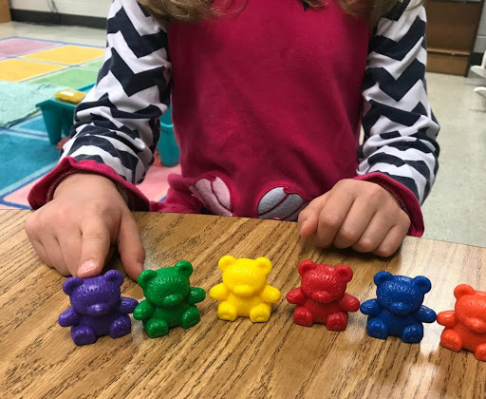
The counting principles
The one-one principle: counting with one to one correspondence. Involves children assigning one number name to each object that is being counted.
Notes:
Lining things up to count them.
Touching things as you count them.
Crossing things out that can’t be moved.

Slide 7
The counting principles
The Cardinal Principle: the number assigned to the final object in the group is the total number of objects in that group.

Slide 8
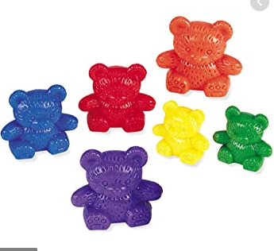
The counting principles
The Order-irrelevance Principle: understanding that the order we count a group of objects is irrelevant. There will always be the same number.
Notes:
Related to the ‘conservation of number’

Slide 9
The counting principles
The Abstraction Principle: understanding that anything can be counted including things which cannot be touched e.g. sounds, movements.

Slide 10
Early Learning Goals / Age Related Expectations / ‘Expected’
Number
Children at the expected level of development will:
Have a deep understanding of number to 10, including the composition of each number;
Subitise (recognise quantities without counting) up to 5;
Automatically recall (without reference to rhymes, counting or other aids) number bonds up to 5 (including subtraction facts)
and some number bonds to 10, including double facts.

Slide 11
Early Learning Goals / Age Related Expectations / ‘Expected’
Numerical Patterns
Children at the expected level of development will:
Verbally count beyond 20, recognising the pattern of the counting system;
Compare quantities up to 10 in different contexts, recognising when one quantity is greater than, less than or the same as the other quantity;
Explore and represent patterns within numbers up to 10, including evens and odds, double facts and how quantities can be distributed equally.
Notes:
Italics = Shape and Measure
Measures
in the environment
(Measures “do it huge, do it outdoors)

Slide 12
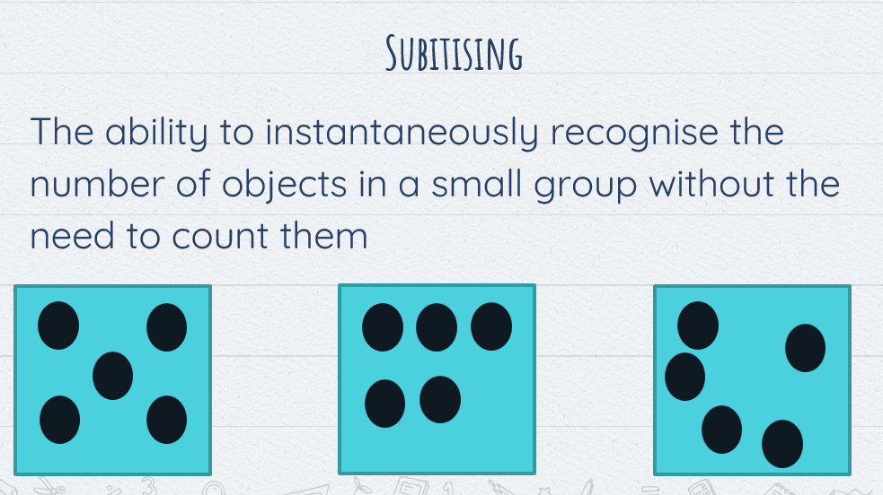
Early Learning goals / Age Related Expectations
Number
Children at the expected level of development will:
Subitise (recognise quantities without counting) up to 5;
Notes:
Subitising is an essential part of developing number sense in early years children by helping them to relate numbers to actual items or groups of items.

Slide 13

Number
Children at the expected level of development will:
Subitise (recognise quantities without counting) up to 5;
Play games with dice – identify the number without counting the spots
Can you see how many (only quantities 0 – 5)
Hiding objects under a cloth with a quick reveal
Notes:
Subitising is an essential part of developing number sense in early years children by helping them to relate numbers to actual items or groups of items.

Slide 14
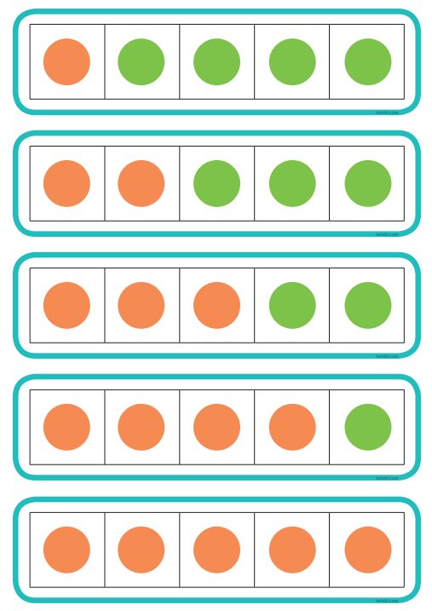

Early Learning goals / Age Related Expectations
Number
Children at the expected level of development will:
Automatically recall (without reference to rhymes, counting or other aids) number bonds up to 5 (including subtraction facts)
and some number bonds to 10, including double facts.

Slide 15
Early Learning goals / Age Related Expectations
Number
Children at the expected level of development will:
Automatically recall (without reference to rhymes, counting or other aids) number bonds up to 5 (including subtraction facts)
and some number bonds to 10, including double facts.
All the same activities that aid understanding of composition, but specifically related to 5 and 10
There are 5 buttons on your coat, I’ve fastened 2, I have 3 left to fasten
With 2 hands, show me five fingers. Can you do it in a different way?
Singing number bond songs
Number bond tennis

Slide 16

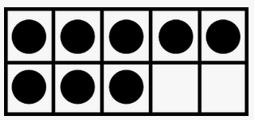
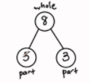



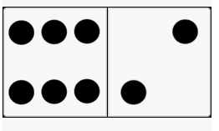


Number
Children at the expected level of development will:
Have a deep understanding of number to 10, including the composition of each number;

Slide 17
Maths At Home
Number
Children at the expected level of development will:
Have a deep understanding of number to 10, including the composition of each number;
Look for opportunities to discuss explicitly the composition of number with real objects / events (little and often)
You have 3 stickers. You had 2 stickers yesterday and 1 today. So 3 altogether
Each of us have 2 shoes, that’s 8 altogether
We have 10 mugs, we could put 5 on each shelf
Skittles: we had 6, you’ve knocked over 2 and there are 4 still standing
Dropping 5 x 1p coins, 3 are heads, 2 are tails
We used to have 3 vases, but 1 broke, so now we have 2
There are 4 ducks in the pond and 2 on the grass, how many altogether?
Number songs e.g. 5 little ducks, 5 currant buns, 5 speckled frogs

Slide 18
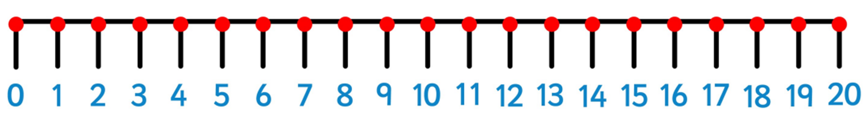
Early Learning goals / Age Related Expectations
Numerical Patterns
Children at the expected level of development will:
Verbally count beyond 20, recognising the pattern of the counting system;

Slide 19
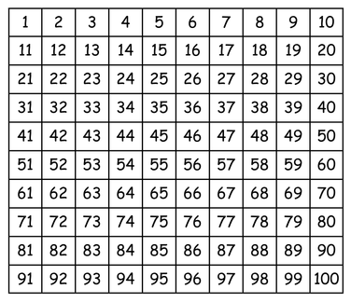
Early Learning goals / Age Related Expectations
Numerical Patterns
Children at the expected level of development will:
Verbally count beyond 20, recognising the pattern of the counting system;

Slide 20
Early Learning goals / Age Related Expectations
Numerical Patterns
Children at the expected level of development will:
Verbally count beyond 20, recognising the pattern of the counting system;
Count forwards and backwards
Count forwards and backwards starting from different numbers
(If I count backwards from 12 to 0, will I say the number 18?)
Count things that can’t be seen
Count things that can and can’t be moved
Play track games

Slide 21
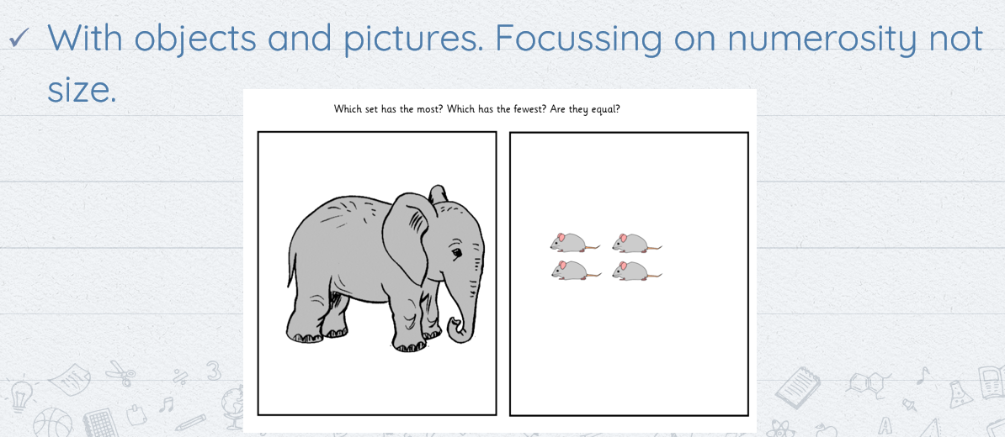
Early Learning goals / Age Related Expectations
Numerical Patterns
Children at the expected level of development will:
Compare quantities up to 10 in different contexts, recognising when one quantity is greater than, less than or the same as the other quantity;
Notes:
Understanding that comparing numbers involves knowing which numbers are worth more or less than each other

Slide 22
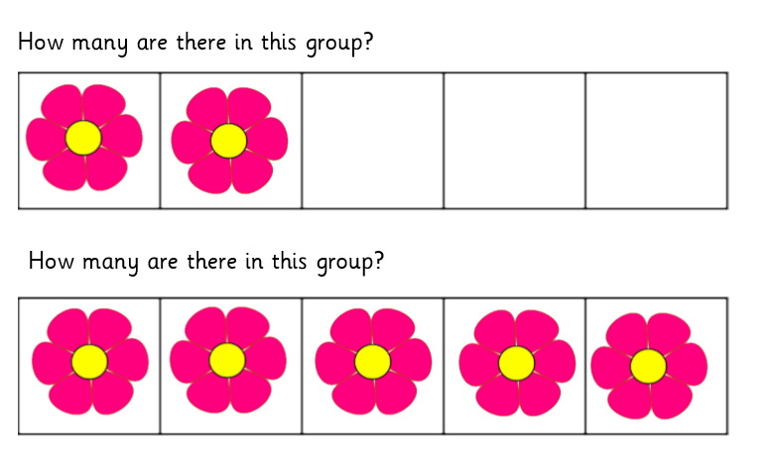
Early Learning goals / Age Related Expectations
Numerical Patterns
Children at the expected level of development will:
Compare quantities up to 10 in different contexts, recognising when one quantity is greater than, less than or the same as the other quantity;
Notes:
Understanding that comparing numbers involves knowing which numbers are worth more or less than each other

Slide 23
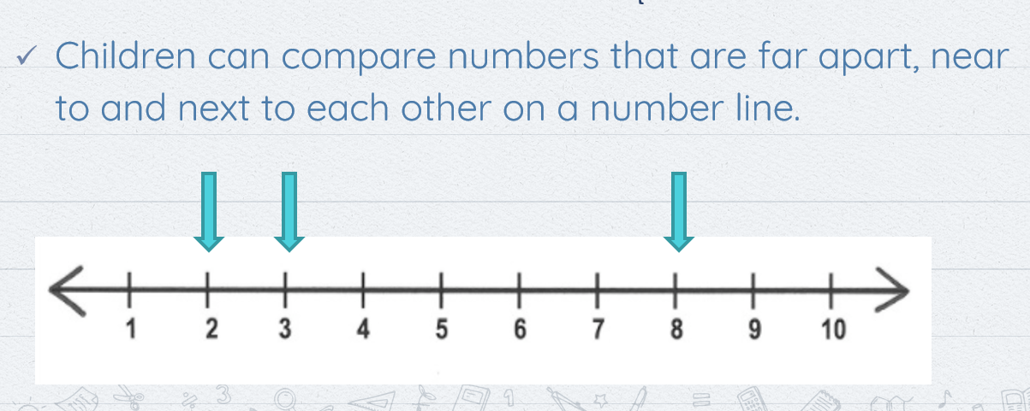
Early Learning goals / Age Related Expectations
Numerical Patterns
Children at the expected level of development will:
Compare quantities up to 10 in different contexts, recognising when one quantity is greater than, less than or the same as the other quantity;

Slide 24
Early Learning goals / Age Related Expectations
Numerical Patterns
Children at the expected level of development will:
Compare quantities up to 10 in different contexts, recognising when one quantity is greater than, less than or the same as the other quantity;
Compare quantities in the environment, there are more bananas than apples in the fruit bowl, there are fewer girls than boys in the playground
(How many more? / How could we make it equal?)
Compare things in different sizes to ensure numerosity e.g. 1 watermelon vs 5 blueberries.
‘Reason’ about numbers: Would you prefer a box with 2 gingerbread men or 5 gingerbread men?
Compare numbers on a numberline that are close or far apart
Notes:
Understanding that comparing numbers involves knowing which numbers are worth more or less than each other

Slide 25
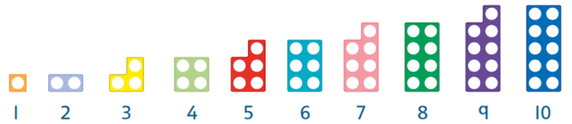
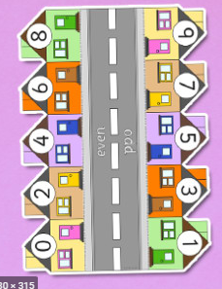
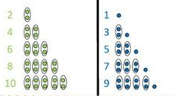
Early Learning goals / Age Related Expectations
Numerical Patterns
Children at the expected level of development will:
Explore and represent patterns within numbers up to 10, including evens and odds, double facts and how quantities can be distributed equally.

Slide 26
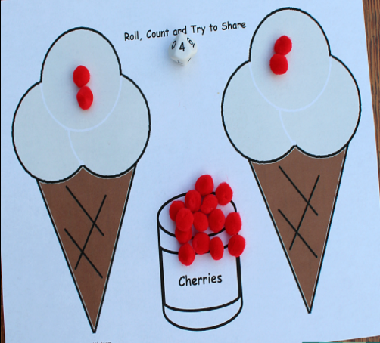
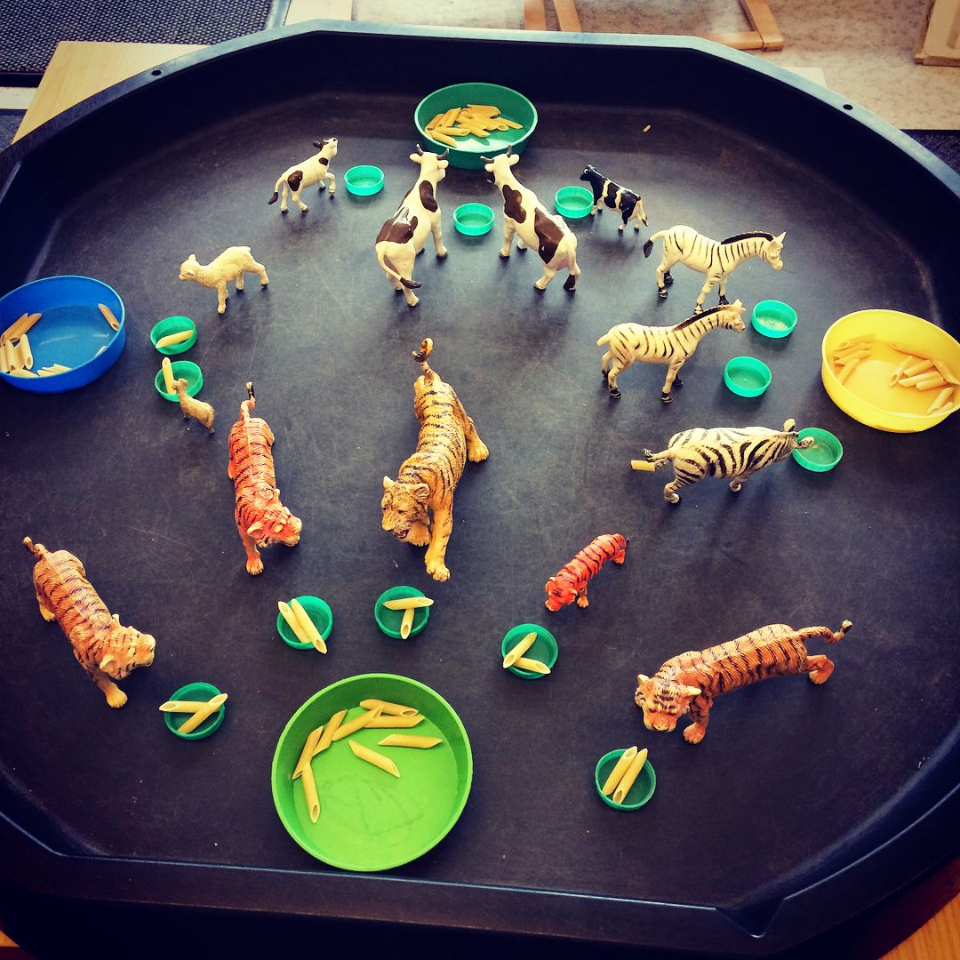
Early Learning goals / Age Related Expectations
Numerical Patterns
Children at the expected level of development will:
Explore and represent patterns within numbers up to 10, including evens and odds, double facts and how quantities can be distributed equally.

Slide 27
Early Learning goals / Age Related Expectations
Numerical Patterns
Children at the expected level of development will:
Explore and represent patterns within numbers up to 10, including evens and odds, double facts and how quantities can be distributed equally.
Discuss odd and even numbers of things e.g. number of family members, number of children in the class.
How could we find out if they’re odd or even?
Discuss ‘pattern’ of odd and even numbers (1, 3, 5, 7, 9 / 0, 2, 4, 6, 8)
Share things evenly (set up in advance if poss) e.g. 6 biscuits with 3 teddies
Re-distribute items that have been shared unfairly / unequally

Slide 28
What this looks like in the classroom
Weekly objective
Daily lessons contributing to this objective
Main teacher led small group activity
Daily independent activities
Daily free flow activities

