Slide 1
YEAR 2
English
What children learn, and how we teach it
2026–27
Notes:
Source: National Curriculum in England, English programmes of study; Standards and Testing Agency teacher assessment guidance. Existing school examples retained from the supplied presentation.

Slide 2
YEAR 2 ENGLISH
Today’s focus
1 The curriculum
2 Classroom practice
3 Assessment
The key knowledge and skills children develop across spoken language, reading and writing.
How high-quality texts, purposeful talk and a clear writing process support progress.
How teachers build a rounded picture over time and describe children’s attainment.
The aim: shared expectations and consistent language across Year 2.
02
Notes:
Source: National Curriculum in England, English programmes of study; Standards and Testing Agency teacher assessment guidance. Existing school examples retained from the supplied presentation.

Slide 3
YEAR 2 ENGLISH
The English curriculum
Spoken language
Reading
Writing
Listening, responding, explaining ideas and taking part in purposeful discussion.
Accurate word reading, fluency and comprehension.
Transcription, composition, vocabulary, grammar and punctuation.
Spoken language runs through every subject and supports both reading and writing.
03
Notes:
Source: National Curriculum in England, English programmes of study; Standards and Testing Agency teacher assessment guidance. Existing school examples retained from the supplied presentation.

Slide 4
SPOKEN LANGUAGE
Spoken language underpins learning
Children need regular opportunities to:
What this sounds like
• listen and respond to others
• explain their thinking clearly
• build on a partner’s idea
• ask relevant questions
• use new vocabulary in context
“I agree because…”
“Another possibility is…”
“The evidence in the text suggests…”
“I would like to add…”
04
Notes:
Source: National Curriculum in England, English programmes of study; Standards and Testing Agency teacher assessment guidance. Existing school examples retained from the supplied presentation.

Slide 5
READING
Reading has two connected strands
Word reading
Comprehension
Children apply phonics, recognise common exception words and develop increasing fluency.
Children understand, discuss and respond to texts that become increasingly rich and varied.
Fluency frees children to focus their attention on meaning.
05
Notes:
Source: National Curriculum in England, English programmes of study; Standards and Testing Agency teacher assessment guidance. Existing school examples retained from the supplied presentation.

Slide 6
READING
Word reading: expected by the end of Year 2
• read most two-syllable and multi-syllable words accurately
• read most words containing common suffixes
• read most common exception words
• read familiar texts accurately and fluently
• sound out unfamiliar words accurately without undue hesitation
A useful distinction
Greater-depth reading is seen mainly through children’s understanding, discussion and independent response to texts.
06
Notes:
Source: National Curriculum in England, English programmes of study; Standards and Testing Agency teacher assessment guidance. Existing school examples retained from the supplied presentation.

Slide 7
READING
Comprehension grows through purposeful talk
Infer
Connect
Predict
Use clues from the text and illustrations.
Link ideas to other texts and experiences.
Suggest what may happen and justify it.
Summarise
Question
Visualise
Retell the most important events or ideas.
Ask about plot, characters and vocabulary.
Build a mental picture from the author’s words.
08
Notes:
Source: National Curriculum in England, English programmes of study; Standards and Testing Agency teacher assessment guidance. Existing school examples retained from the supplied presentation.

Slide 8
WRITING
Writing brings three strands together
Transcription
Composition
Grammar and punctuation
Spelling and handwriting become increasingly accurate and automatic.
Children generate, organise, draft, evaluate and improve ideas.
Children use sentence structure and punctuation to make meaning clear.
09
Notes:
Source: National Curriculum in England, English programmes of study; Standards and Testing Agency teacher assessment guidance. Existing school examples retained from the supplied presentation.

Slide 9

WRITING
Transcription: spelling and handwriting
Children continue to apply phonics while building knowledge of spelling patterns, common exception words and suffixes.
• form lower-case and capital letters correctly
• use appropriate spacing between words
• develop a fluent, consistent handwriting style
• spell taught patterns accurately in independent writing
10
Notes:
Source: National Curriculum in England, English programmes of study; Standards and Testing Agency teacher assessment guidance. Existing school examples retained from the supplied presentation.

Slide 10
WRITING
Grammar and punctuation in Year 2
Sentence forms
Description
statements, questions, exclamations and commands
expanded noun phrases that add precise detail
Tense
Joining ideas
consistent present and past tense, including the progressive form
co-ordination with and, but or or; subordination with when, if, that or because
11
Notes:
Source: National Curriculum in England, English programmes of study; Standards and Testing Agency teacher assessment guidance. Existing school examples retained from the supplied presentation.

Slide 11
WRITING
Punctuation supports meaning
.
?
!
,
’
full stop
question mark
exclamation mark
comma
apostrophe
ends a statement
ends a question
shows strong feeling or emphasis
separates items in a list
marks contraction or singular possession
12
Notes:
Source: National Curriculum in England, English programmes of study; Standards and Testing Agency teacher assessment guidance. Existing school examples retained from the supplied presentation.

Slide 12
WRITING
A clear composition cycle
1
2
3
4
5
Read
Explore
Plan
Draft
Review
Experience strong models and build knowledge.
Talk, rehearse, notice structure and vocabulary
Shape ideas, structure and language choices.
Write with the purpose and reader in mind.
Evaluate, edit, improve and publish.
13
Notes:
Source: National Curriculum in England, English programmes of study; Standards and Testing Agency teacher assessment guidance. Existing school examples retained from the supplied presentation.

Slide 13
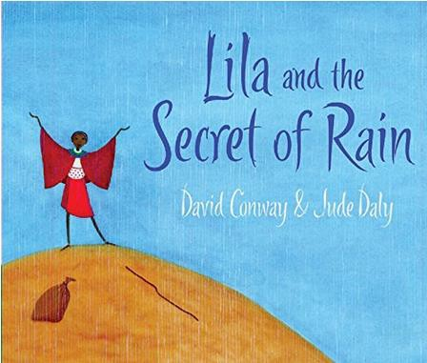



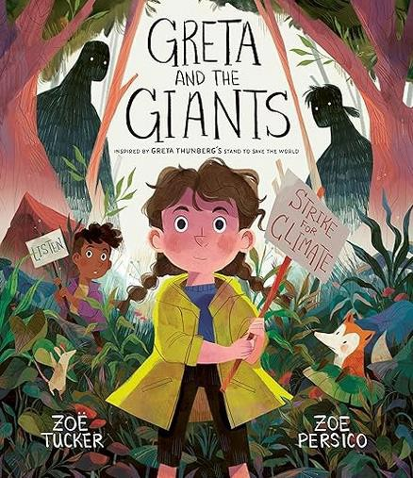

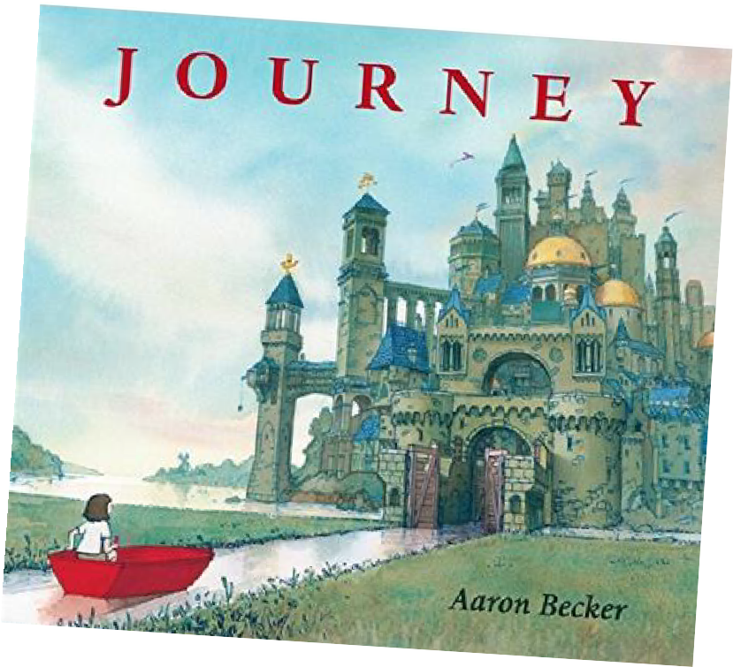


COMPOSITION
1. Read: start with high-quality texts
Texts give children something worth thinking about and a rich model of what writing can do.
Purposeful reading builds vocabulary, sentence patterns, knowledge and imagination.
14
Notes:
Source: National Curriculum in England, English programmes of study; Standards and Testing Agency teacher assessment guidance. Existing school examples retained from the supplied presentation.

Slide 14
COMPOSITION
2. Explore
Children deepen their understanding before they write.
• discuss characters, events and ideas
• collect and rehearse useful vocabulary
• notice how authors shape sentences
• use drama and oral rehearsal to develop voice
15
Notes:
Source: National Curriculum in England, English programmes of study; Standards and Testing Agency teacher assessment guidance. Existing school examples retained from the supplied presentation.

Slide 15
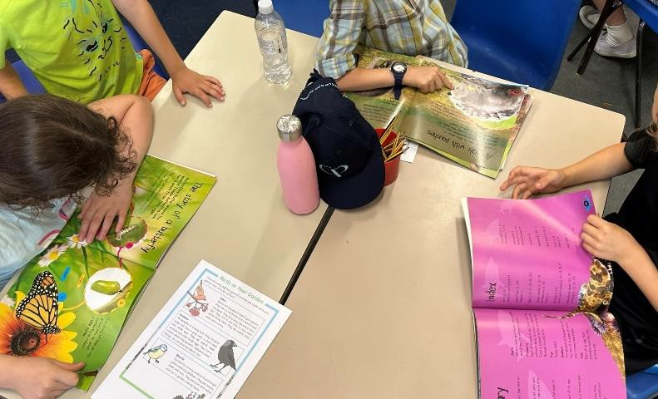
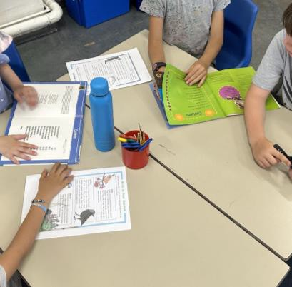
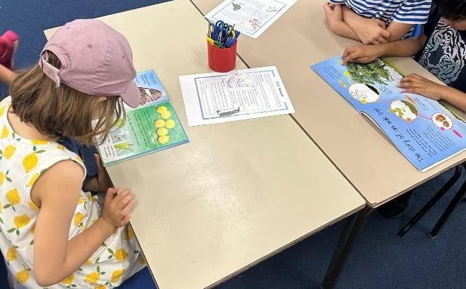
COMPOSITION
3. Notice how the text works
Children compare examples and identify what helps the reader.
Questions to explore
What do these texts have in common?
How has the writer organised the ideas?
Which language choices are effective?
What will our success criteria include?
16
Notes:
Source: National Curriculum in England, English programmes of study; Standards and Testing Agency teacher assessment guidance. Existing school examples retained from the supplied presentation.

Slide 16
COMPOSITION
4. Plan: shape ideas before drafting
Purpose
Reader
Language and structure
What am I writing and why?
Who will read it? What will help them?
Which vocabulary, sentence patterns and organisation will work best?
A useful plan supports thinking without becoming a writing task in itself.
17
Notes:
Source: National Curriculum in England, English programmes of study; Standards and Testing Agency teacher assessment guidance. Existing school examples retained from the supplied presentation.

Slide 17
COMPOSITION
5. Draft, review and improve
The first version gives children something to work on.
• reread for meaning and clarity
• check spelling and punctuation already taught
• make purposeful additions or changes
• respond to focused feedback
• publish when the final outcome merits it
18
Notes:
Source: National Curriculum in England, English programmes of study; Standards and Testing Agency teacher assessment guidance. Existing school examples retained from the supplied presentation.

Slide 18
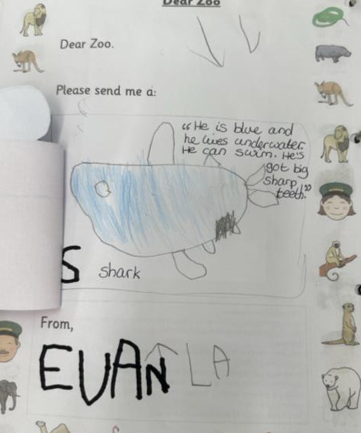
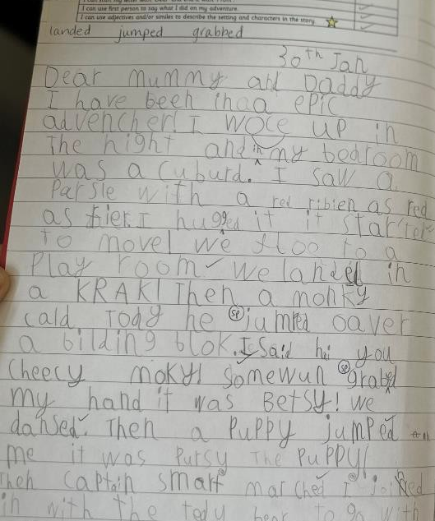
COMPOSITION
Progression is visible over time
Children build on earlier experiences of mark-making, oral composition, phonics and sentence construction.
What develops
Ideas become more sustained, sentences more controlled and choices more deliberate.
What remains
Oral rehearsal, reading aloud and purposeful response continue to support every stage.
Nursery
Year 1
19
Notes:
Source: National Curriculum in England, English programmes of study; Standards and Testing Agency teacher assessment guidance. Existing school examples retained from the supplied presentation.

Slide 19
READING INTO WRITING
Reading feeds writing
“The best writers were the children who read avidly… these children had been internalising narrative patterns, the language of stories, and recycling them in their heads.”
Pie Corbett
Repeated encounters with rich texts help children develop an ear for language and a repertoire of structures.
20
Notes:
Source: National Curriculum in England, English programmes of study; Standards and Testing Agency teacher assessment guidance. Existing school examples retained from the supplied presentation.

Slide 20

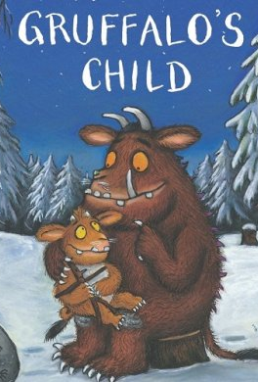

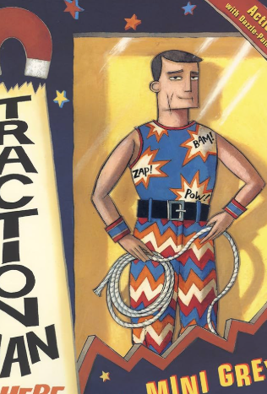

READING INTO WRITING
Story patterns support confident composition
Losing tale
Conquering the monster
Journey tale
Character flaw
Meeting tale
Repetitive tale
Wishing tale
21
Notes:
Source: National Curriculum in England, English programmes of study; Standards and Testing Agency teacher assessment guidance. Existing school examples retained from the supplied presentation.

Slide 21
ASSESSMENT
Teaching and assessment work together
Curriculum
Evidence over time
Final judgement
The National Curriculum sets out what schools teach.
Teachers draw on day-to-day learning, children’s independent work and what they know about each child.
Schools report whether a child is working towards, at the expected standard or at greater depth.
The former statutory teacher assessment frameworks may still support professional discussion, but they no longer determine the statutory judgement.
22
Notes:
Source: National Curriculum in England, English programmes of study; Standards and Testing Agency teacher assessment guidance. Existing school examples retained from the supplied presentation.

Slide 22
The shared Year 2 approach
Rich experiences
Explicit teaching
Independent application
High-quality texts, talk and purposeful contexts give children strong content for reading and writing.
Teachers model the knowledge, vocabulary and processes children need, then gradually release responsibility.
Children have regular opportunities to apply taught skills independently and show what they know over time.
Questions and discussion
Notes:
Source: National Curriculum in England, English programmes of study; Standards and Testing Agency teacher assessment guidance. Existing school examples retained from the supplied presentation.

